Slide 1
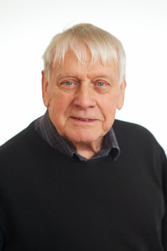
Key Study: Baddeley (1966b)
Notes:
Intentionally not told them the title, because I want them to replicate part of the study & if they were told the title, it may further bias their performance!
Tricky study & their first key study – so we will go through together.
This is a named study – so need to know this one really well.
This is a pic of Baddeley now – not when he did his study in the 60s! If you’re thinking of going to Uni – at the moment he is at York University (which is v good for Psych).

Slide 2
Learning Objectives
To describe the Baddeley (1966b) study.
To evaluate the Baddeley (1966b) study using the GRAVE format.
To answer exam questions on the Baddeley (1966b) study.

Slide 3
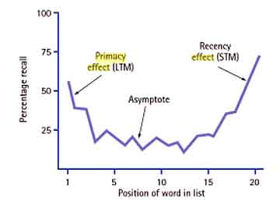
But First....
1. What is the serial-position/primacy-recency effect? (Murdock, 1962)

Slide 4
But First...
2. What is rehearsal? (in a memory sense!)

Slide 5
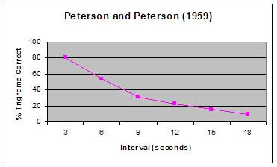
But First...
3. What did Peterson-Peterson (1959) do to prevent rehearsal? What did they find?

Slide 6
You are about to replicate part of Baddeley’s (1966b) study - Experiment 3
You will be shown a series of words.
You need to remember the order of the words.
Notes:
Show each word for 3 seconds

Slide 7
Man

Slide 8
Cab

Slide 9
Can

Slide 10
Cad
Notes:
Cad = a man who behaves dishonourably, especially towards a woman

Slide 11
Cap

Slide 12
Mad

Slide 13
Max

Slide 14
Mat

Slide 15
Cat

Slide 16
Map

Slide 17
I am going to read out loud some number sequences.
You need to listen to the number sequences.
After each sequence has been read out to you, you will be given the chance to write them down in the correct order.
Notes:
No writing until I get to the end of the number sequences.
73735459
63781346
38730296
55830390
70820025
98859238

Slide 18
Now...
You have 1 minute to recall the word list in the correct order.
These are the words that appeared:
Cat Max
Cab Mat
Cap Cad
Map Can
Man Mad
Notes:
We’ll go through answers later

Slide 19
Baddeley (1966b) did this 3 more times with the same list of words
Why might he have done that?
Notes:
To see if LTM improves over time.

Slide 20
Questions to Consider
Why did Baddeley show the words used when Ps were asked to recall them?
What was the relevance of having to remember those number sequences?
The words used were all acoustically similar. There were 3 other conditions in this experiment. What could they have been?
Notes:
Because it was a test of being able to remember the order, not a test about the ability to remember the words themselves.
To prevent rehearsal – i.e. To prevent STM – so you were only using LTM. Wants to be a test of LTM, not STM.
Acoustically dissimilar, semantically similar & semantically dissimilar.

Slide 21
Which words belong to which condition?
Acoustically similar
Acoustically dissimilar
Semantically similar
Semantically dissimilar
Pit, few, cow, pen, sup, bar, day, hot, rig, bun
Good, huge, hot, safe, thin, deep, strong, foul, old, late
Great, big, large, huge, long, tall, fat, wide, high, broad
Cat, max, cap, can, man, map, mat, mad, cad, cab
Notes:
B – acoustically dissimilar
D – semantically dissimilar
C – semantically similar
A – acoustically similar

Slide 22
Questions to think about
What difference do you think each of these conditions will make to memory?
What controls do you think Baddeley will need to have used when choosing which words to include in his study?
Can you guess what the aim of this study was?
Notes:
Should know that acoustic & semantic comes from encoding information. STM is supposed to encode info acoustically & LTM is supposed to encode info semantically
Frequency of the words used in the English language. There are publications out there, which list how frequent each type of word is – wants similarly frequent words – why??? Might make some words more/less distinctive depending on the frequency. We replicated this study – 1 word probably stood out – cad – because it is no longer frequent – case in point ☺

Slide 23
Aim
To investigate the influence of acoustic and semantic word similarity on learning and recall in long-term memory. The results of this study will inform our understanding of how information is encoded in LTM, which in turn tests the parameters of the Multi-Store Model of memory.
Why would this study test the parameters of the MSM of memory?

Slide 24
Surprise!!!
You need to recall & write down the list of words, in the correct order again.
As a reminder, these are the words that were used:
Map Cap
Cat Cad
Mat Can
Max Cab
Mad Man

Slide 25
How many did you get right, first time & second time?
Man
Cab
Can
Cad
Cap
Mad
Max
Mat
Cat
Map
Calculate your number of correct answers as a percentage
First time round
Second time round
Notes:
Mark their work. See how them compare to the original????
I.e. Put results as a fraction, divide the top by the bottom, then multiply by 100.

Slide 26
How do our results compare with Baddeley’s (1966b)?
Notes:
We did the acoustic similarity condition – trial 1 and the retest.
Baddeley obviously collected in everybody’s results – take too long – you can calculate your own percentage & see how you compare.
Identify which is List A, B, C & Don the graphs

Slide 27
What conclusion(s) can you deduce from Baddeley’s results?
Notes:
That semantic similarity has a significant impairment on performance of LTM (fewer semantically similar words were recalled than semantically dissimilar, or acoustically similar/dissimilar).

Slide 28
Note Check
Aim
Procedure
Results
Conclusion
Notes:
Read through the notes together (will need to print the updated notes???) Make sure that they understand the description of this study.

Slide 29
Choose a number between 100 and 200 (inclusively).
Write this number on your Baddeley notes.
Notes:
So you can choose 100 & 200 if you wish.

Slide 30
Condensing Information Improves Memory
You need to process the information semantically, in order to decide which bits are the most important (should be included) & least important (should be discarded).
We’re in the business of remembering as much as we can ☺
Notes:
So understanding will help that process ☺

Slide 31
Homework
Draw a pair of briefs.
Summarise the description for the Baddeley (1966b) study using the number you have written on your notes as your MAXIMUM word count ☺
Use as many abbreviations, diagrams etc as you wish.

Slide 32
Evaluating Studies
State
How
Why
Notes:
In the student notes I have written the state & the how, but we need to fill in the why.
Get students to discuss this first (don’t write anything down!) could jot ideas on lined paper. Then come back together & write together.
Haven’t followed GRAVE in the notes. Get students to think of additional evaluation points for generalisability, reliability, validity & ethics. Within replicability – could do with emphasising that scientific methods were used, so can est reliability (to tick the issues & debates box).

Slide 33
Exam Style Questions About This Study
What was the aim?
How did Baddeley (1966b) conduct this study?
What results did Baddeley (1966b) find?
What was the conclusion of Baddeley’s (1966b) study?
Describe Baddeley’s (1966b) study investigating the influence of acoustic and semantic similarity on LTM.
Describe the aim and procedure of Baddeley’s (1966b) study
Describe one strength of Baddeley’s (1966b) study.
Explain how Baddeley’s (1966b) study might have low ecological validity.
Describe one way that Baddeley (1966b) could have improved his study.
Etc.
Notes:
Lots of different questions that could be asked.
Given it’s such a big study – unlikely (but not impossible) that they will ask you to describe the study. Likely to ask you to describe part of the study.
Equally – lots of evaluation points are possible – so likely to ask you to give 1 / 2 evaluation points rather than to just evaluate the study.
Choose a question for your neighbour to answer.

