Slide 1
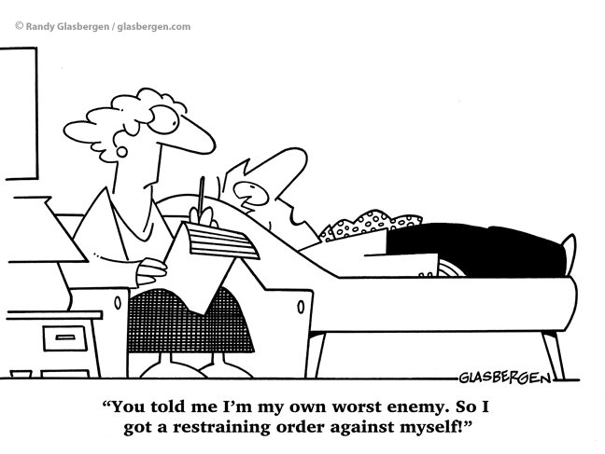
Social Approach
Methodology
Describe qualitative and quantitative data
Evaluate quantitative and qualitative data
Understand the difference between the strengths and weaknesses of quantitative and qualitative data
Key words:
Qualitative
Quantitative
Surveys

Slide 2

Starter
Describe qualitative and quantitative data
Evaluate quantitative and qualitative data
Understand the difference between the strengths and weaknesses of quantitative and qualitative data
Key words:
Qualitative
Quantitative
Surveys
You have 30 seconds to think of as many key terms from methodology that you can.
http://www.online-stopwatch.com/
Lesson 1

Slide 3
Lesson outcomes
Describe qualitative and quantitative data
Evaluate quantitative and qualitative data
Understand the difference between the strengths and weaknesses of quantitative and qualitative data
Describe open and closed questions and be able to identify them
Identify what type of data each question type will generate
Calculate measures of central tendency and measures of dispersion.

Slide 4

SURVEYS
Describe qualitative and quantitative data
Evaluate quantitative and qualitative data
Understand the difference between the strengths and weaknesses of quantitative and qualitative data
Key words:
Qualitative
Quantitative
Surveys
Surveys are planned with an aim in mind e.g. ‘to find out attitudes to prejudice’. The aim of a study should be summed up in a general statement.
Surveys are a commonly used research method in social psychology. A survey can be thought of as an umbrella term for a number of different research designs including questionnaires and interviews.
These methods investigate specific research questions by gathering self-report data.

Slide 5
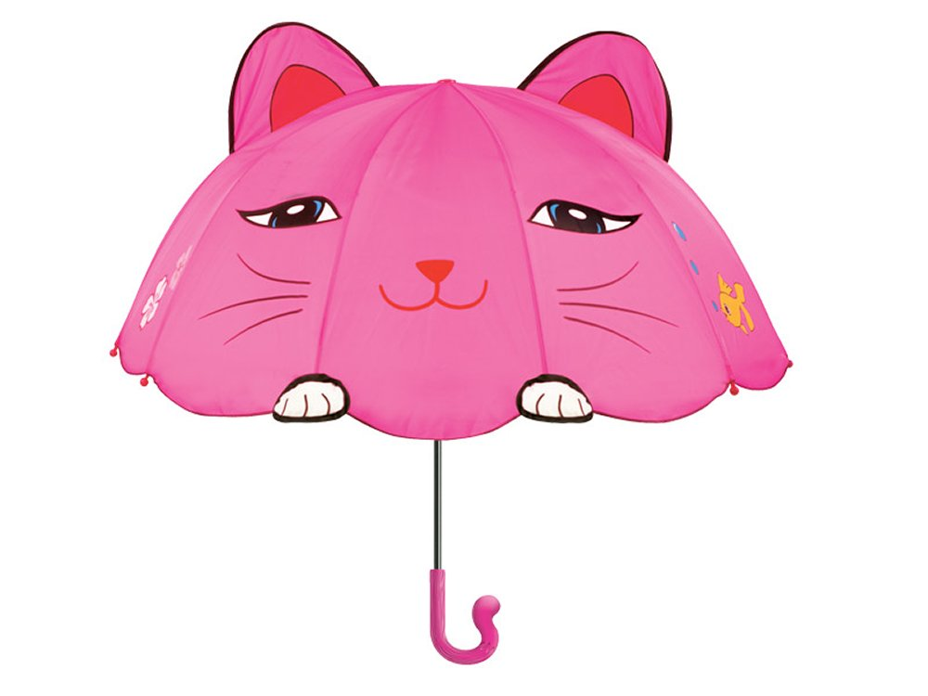

Describe qualitative and quantitative data
Evaluate quantitative and qualitative data
Understand the difference between the strengths and weaknesses of quantitative and qualitative data
Key words:
Qualitative
Quantitative
Surveys
Surveys come in two forms!
Questionnaires
Interviews

Slide 6

What type of data do surveys give us?
Describe qualitative and quantitative data
Evaluate quantitative and qualitative data
Understand the difference between the strengths and weaknesses of quantitative and qualitative data
Key words:
Qualitative
Quantitative
Surveys
Self-report data
Data compiled by a participant, usually through written questionnaires

Slide 7
Describe qualitative and quantitative data
Evaluate quantitative and qualitative data
Understand the difference between the strengths and weaknesses of quantitative and qualitative data
Key words:
Qualitative
Quantitative
Surveys
Can you think of any potential problems that may arise using self-report data?
People might lie- they may be dishonest
People might not understand the question
At the core of this method is questioning. How you ask the questions is extremely important.

Slide 8

Gathering data using surveys
Describe qualitative and quantitative data
Evaluate quantitative and qualitative data
Understand the difference between the strengths and weaknesses of quantitative and qualitative data
Key words:
Qualitative
Quantitative
Surveys
You can interview participants face to face or over the phone by asking questions and then recording their answers.
You could send them a questionnaire, a written set of questions, requiring them to write their response and send it back to you.
Both of these methods allow you to make use of open or closed questions. The key to getting useful results, is asking the right questions.

Slide 9


Types of questions and the types of data they generate
Describe qualitative and quantitative data
Evaluate quantitative and qualitative data
Understand the difference between the strengths and weaknesses of quantitative and qualitative data
Key words:
Qualitative
Quantitative
Surveys
An open question is one that can be answered in any way the participant chooses. It yields qualitative data- data that consists of words that describe the participant’s views.
A closed question limits the responses that can be made e.g. yes or no. It yields quantitative data- data that can be reduced to numbers or quantities.

Slide 10
Fill in the gaps
Describe qualitative and quantitative data
Evaluate quantitative and qualitative data
Understand the difference between the strengths and weaknesses of quantitative and qualitative data
Key words:
Qualitative
Quantitative
Surveys
Open questions → Qualitative data
Closed questions → Quantitative data

Slide 11

Task
Describe qualitative and quantitative data
Evaluate quantitative and qualitative data
Understand the difference between the strengths and weaknesses of quantitative and qualitative data
Key words:
Qualitative
Quantitative
Surveys
Read the description of and evaluation of qualitative and quantitative data on page 5
What do you notice about the strengths and weaknesses of the two types of data?
How could we write this as a formula to remember?

Slide 12

Milgram’s study
Describe qualitative and quantitative data
Evaluate quantitative and qualitative data
Understand the difference between the strengths and weaknesses of quantitative and qualitative data
Key words:
Qualitative
Quantitative
Surveys
Think of examples of both qualitative and quantitative findings in Milgram’s original study.
Summarise them in a table.
students!
Now do the same for another study from either the Social Approach or Biological Approach.

Slide 13
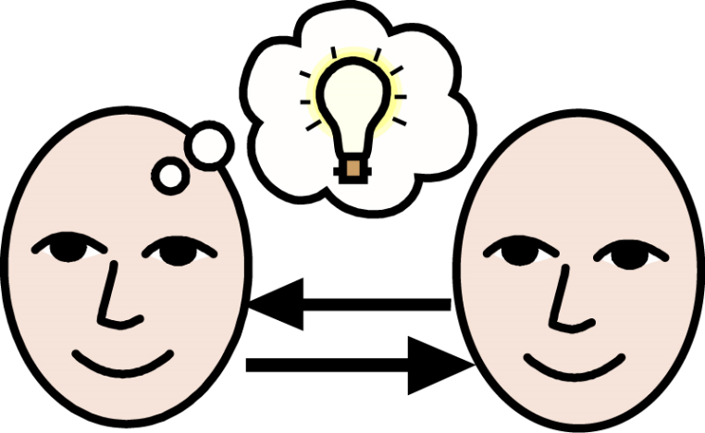
Qualitative or Quantitative?
Describe qualitative and quantitative data
Evaluate quantitative and qualitative data
Understand the difference between the strengths and weaknesses of quantitative and qualitative data
Key words:
Qualitative
Quantitative
Surveys
Complete the activity in the booklet, and check with the person sat next to you.

Slide 14

Answers
Describe qualitative and quantitative data
Evaluate quantitative and qualitative data
Understand the difference between the strengths and weaknesses of quantitative and qualitative data
Key words:
Qualitative
Quantitative
Surveys
Quantitative
Quantitative
Qualitative
Quantitative
Quantitative
Quantitative
Qualitative

Slide 15
Describe qualitative and quantitative data
Evaluate quantitative and qualitative data
Understand the difference between the strengths and weaknesses of quantitative and qualitative data
Key words:
Qualitative
Quantitative
Surveys
“Why did you start to study psychology?”
Is this an open question or a closed question?
Explain your answer.
This is an open question because it is asking for peoples opinions about why they started to study psychology. It does not give them options to choose from and therefore does not restrict participants answers in the way that a closed question might

Slide 16
Task: Think of what you know about social psychology so far. Write two examples of open and closed questions that you think would be of interest as research questions.
Describe qualitative and quantitative data
Evaluate quantitative and qualitative data
Understand the difference between the strengths and weaknesses of quantitative and qualitative data
Key words:
Qualitative
Quantitative
Surveys
Closed question 1: Would you feel bad if a teacher asked you to hit another student and you did it? Yes/ No
Closed question 2: Rate the likelihood that you would obey a police officers orders to inflict harm on another person (1- Very likely, 5- Very unlikely)
Open question 1: Why do you think that you obey you teachers?
Open question 2: Do you think that football fans are prejudice towards fans from other teams? Explain your answer.

Slide 17
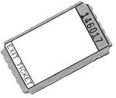
Plenary
Describe qualitative and quantitative data
Evaluate quantitative and qualitative data
Understand the difference between the strengths and weaknesses of quantitative and qualitative data
Key words:
Qualitative
Quantitative
Surveys
Exit ticket

Slide 18
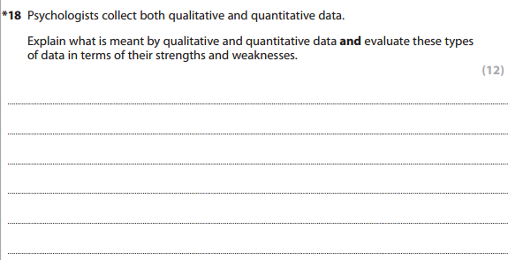
Be warned!
Describe qualitative and quantitative data
Evaluate quantitative and qualitative data
Understand the difference between the strengths and weaknesses of quantitative and qualitative data
Key words:
Qualitative
Quantitative
Surveys

Slide 19
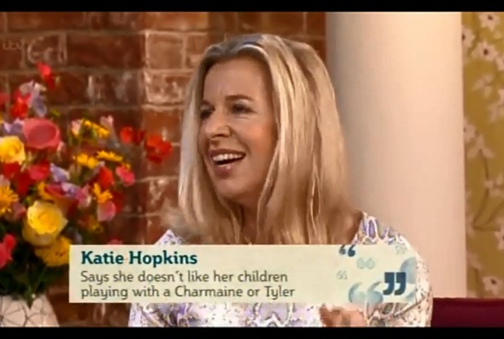
Interviews
Describe the features of and evaluate 3 types of interviews
Identify an appropriate interview type for different types of interview topics/situations
Understand why social psychologists make use of interviews
Key words:
Interview
Structured
Unstructured
Lesson 2

Slide 20
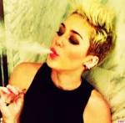
Starter
Describe the features of and evaluate 3 types of interviews
Identify an appropriate interview type for different types of interview topics/situations
Understand why social psychologists make use of interviews
Key words:
Interview
Structured
Unstructured
In pairs interview each other for 2 minutes each. The topic of interest is:
The portrayal of women in the media!
What problems did you encounter?

Slide 21

Learning objectives
Key words:
Interview
Structured
Unstructured
Describe the features of and evaluate 3 types of interviews
Identify an appropriate interview type for different types of interview topics/situations
Understand why social psychologists make use of interviews

Slide 22
INTERVIEWS
Researchers can ask closed questions during an interview but you can probe the participant to find out what lies behind superficial attitudes.
Describe the features of and evaluate 3 types of interviews
Identify an appropriate interview type for different types of interview topics/situations
Understand why social psychologists make use of interviews
Key words:
Interview
Structured
Unstructured
Interviews come in three forms:
Unstructured interviews
Structured interviews
Semi-structured interviews
Which type do you think you had when you were interviewed to come into the Sixth Form?

Slide 23

Watch this YouTube clip
Describe the features of and evaluate 3 types of interviews
Identify an appropriate interview type for different types of interview topics/situations
Understand why social psychologists make use of interviews
Key words:
Interview
Structured
Unstructured
https://www.youtube.com/watch?v=iIJ4zTe-eDU
Count how many open and closed questions are used in this interview.

Slide 24

Interviews
Describe the features of and evaluate 3 types of interviews
Identify an appropriate interview type for different types of interview topics/situations
Understand why social psychologists make use of interviews
Key words:
Interview
Structured
Unstructured
Interviews mainly gather qualitative data, and so are used when in-depth data is required.
There is likely to be some quantitative data e.g. age, or yes/no questions.
The more structured an interview is, the more likely it is to include quantitative data. The less structured an interviews is the more likely it is to generate qualitative data.
Read the rest of the section in your booklet

Slide 25
Features of Interviews
Describe the features of and evaluate 3 types of interviews
Identify an appropriate interview type for different types of interview topics/situations
Understand why social psychologists make use of interviews
Key words:
Interview
Structured
Unstructured
Complete part 1 of this table, for each type of Interview
 | Features | Strengths | Weaknesses
Structured interviews
Semi-structured interviews
Unstructured interviews

Slide 26
Describe the features of and evaluate 3 types of interviews
Identify an appropriate interview type for different types of interview topics/situations
Understand why social psychologists make use of interviews
Key words:
Interview
Structured
Unstructured
Issues to consider- participants should see:
The interview schedule (a set of questions and the time required).
The chosen format for recording the interview.
The full transcript of the interview (and agree with what has been recorded).

Slide 27
Describe the features of and evaluate 3 types of interviews
Identify an appropriate interview type for different types of interview topics/situations
Understand why social psychologists make use of interviews
Key words:
Interview
Structured
Unstructured
Subjectivity and objectivity
In all research, the researcher can cause bias. Social desirability, demand characteristics and response bias can all affect interviews.
Researchers can cause bias by interpreting the results using their own views (subjectivity). Objectivity is when there is no bias affecting the results. Scientific studies must be objective.

Slide 28
Getting you thinking!
Describe the features of and evaluate 3 types of interviews
Identify an appropriate interview type for different types of interview topics/situations
Understand why social psychologists make use of interviews
Key words:
Interview
Structured
Unstructured
Strengths and weaknesses of interviews

Slide 29
EVALUATION OF INTERVIEWS
STRENGTHS
interviews enable a large amount of data to be collected which is descriptive and may give a better picture of what is going on in real life so are valid to what is being studied
interviews give access to information which is not available through direct observation, such as what individuals think and feel about certain topics which again makes it a more valid method.
interviews can gather a lot of information which can produce results which give insight into areas which may not have been thought of for example, if you are looking at people attitudes towards hard drug users you may not have thought of in your survey those who are ill and use prescribed drugs long-term.
PEE!

Slide 30

EVALUATION OF INTERVIEWS
WEAKNESSES
in interviews people often don’t know what they feel or do, and therefore are forced to rely on “social desirability”, meaning that they tend to answer a question in the way that seems most representative of “good” behaviour. This produces a SOCIAL DESIRABILITY a form of bias and reduces the reliability of the results.
in interviews the analysis of the information can be subjective especially if one person is carrying out the research, they may miss important information that others would pick up because of their personal opinions, ie RESEARCHER BIAS.

Slide 31
Evaluation of Interviews
Describe the features of and evaluate 3 types of interviews
Identify an appropriate interview type for different types of interview topics/situations
Understand why social psychologists make use of interviews
Key words:
Interview
Structured
Unstructured
Challenge students:
Try to add another strength and weakness
Complete parts 2 & 3 of this table, for each type of Interview
 | Features | Strengths | Weaknesses
Structured interviews
Semi-structured interviews
Unstructured interviews

Slide 32
When and where and why?
Describe the features of and evaluate 3 types of interviews
Identify an appropriate interview type for different types of interview topics/situations
Understand why social psychologists make use of interviews
Key words:
Interview
Structured
Unstructured
In pairs think of examples of when, where and why social psychologists have/might use interviews.
When?
Why?
Where?

Slide 33
Homework
Describe qualitative and quantitative data
Evaluate quantitative and qualitative data
Understand the difference between the strengths and weaknesses of quantitative and qualitative data
Key words:
Qualitative
Quantitative
Surveys
January 2009 Unit 1
Explain why in psychology it might be preferable to use a research method that produces qualitative rather than quantitative data? (4 marks)

Slide 34
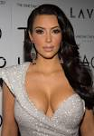
Plenary
Describe the features of and evaluate 3 types of interviews
Identify an appropriate interview type for different types of interview topics/situations
Understand why social psychologists make use of interviews
Key words:
Interview
Structured
Unstructured
Challenge question!
Convince me that structured interviews are better than unstructured interviews
For each of the following interview scenarios, choose the type of interview you think would work best and justify your answer.
An interview with Kim Kardashian
An interview with the Headteacher of your school
An interview with the Police

Slide 35

Questionnaires
Describe the features of and evaluate questionnaires
Create unambiguous open and closed questions suitable for questionnaires
Understand why social psychologists make use of questionnaires
Key words:
Likert
Rating
Standardised
Lesson 3

Slide 36
Learning objectives
Key words:
Likert
Rating
Standardised
Describe the features of and evaluate questionnaires
Create unambiguous open and closed questions suitable for questionnaires
Understand why social psychologists make use of questionnaires

Slide 37

Starter
Describe the features of and evaluate questionnaires
Create unambiguous open and closed questions suitable for questionnaires
Understand why social psychologists make use of questionnaires
Key words:
Likert
Rating
Standardised
List the questionnaires you have filled in during your life time.
Tip.... Where have you registered?
You have 5 minutes.
http://www.online-stopwatch.com/

Slide 38
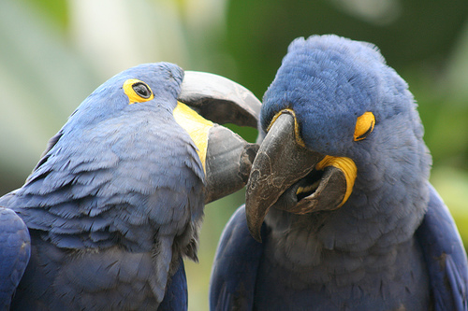
QUESTIONNAIRES
Describe the features of and evaluate questionnaires
Create unambiguous open and closed questions suitable for questionnaires
Understand why social psychologists make use of questionnaires
Key words:
Likert
Rating
Standardised
Questionnaires involve asking people what they think about a topic of interest. Questionnaires have to be designed carefully. They ask for personal data e.g. age, gender and background.
In pairs, discuss what problems you encountered whilst completing your questionnaire and also what went well. Write them down ready to feed back to the rest of the class.

Slide 39
QUESTIONNAIRES
Describe the features of and evaluate questionnaires
Create unambiguous open and closed questions suitable for questionnaires
Understand why social psychologists make use of questionnaires
Key words:
Likert
Rating
Standardised
Adorno et al (1950) used a questionnaire to see if authoritarian personality linked to prejudice. They developed a “fascism” scale. Their findings suggested that people who were more fascist (authoritarian) were more prejudiced in their views. This suggests that personality relates to prejudice.

Slide 40
QUESTIONNAIRES
Describe the features of and evaluate questionnaires
Create unambiguous open and closed questions suitable for questionnaires
Understand why social psychologists make use of questionnaires
Key words:
Likert
Rating
Standardised
Because questionnaires involve a written format there is no flexibility about the questions. Space can be left for the participants to write comments but otherwise set questions are answered. Questions are most likely to be closed and may make use of a Likert-type scale.

Slide 41
Features of Questionnaires
Describe the features of and evaluate questionnaires
Create unambiguous open and closed questions suitable for questionnaires
Understand why social psychologists make use of questionnaires
Key words:
Likert
Rating
Standardised
Complete part 1 of this table for questionnaires
 | Features | Strengths | Weaknesses
Questionnaires

Slide 42

Types of scales
Describe the features of and evaluate questionnaires
Create unambiguous open and closed questions suitable for questionnaires
Understand why social psychologists make use of questionnaires
Key words:
Likert
Rating
Standardised
There are a variety of scales used in questionnaires. They include:
Likert scales
Rating scales
Identification scales
Read through your booklet to find out the features of each one and try the examples.

Slide 43
Getting you thinking!
Describe the features of and evaluate questionnaires
Create unambiguous open and closed questions suitable for questionnaires
Understand why social psychologists make use of questionnaires
Key words:
Likert
Rating
Standardised
Strengths and weaknesses of questionnaires

Slide 44
EVALUATION OF QUESTIONNAIRES
Describe the features of and evaluate questionnaires
Create unambiguous open and closed questions suitable for questionnaires
Understand why social psychologists make use of questionnaires
Key words:
Likert
Rating
Standardised
STRENGTHS
  the same questions are asked to all participants using the same standardised procedure this means that there is little variation in how people are asked the information, this means that data us realistic and valid and uninfluenced by the researcher.
  By using set procedures the questionnaires can be easily replicated as the same one can be used again therefore ensuring reliability.

Slide 45

EVALUATION OF QUESTIONNAIRES
Describe the features of and evaluate questionnaires
Create unambiguous open and closed questions suitable for questionnaires
Understand why social psychologists make use of questionnaires
Key words:
Likert
Rating
Standardised
WEAKNESSES
  administering questionnaires can be difficult and this may mean other variables like location and others present could influence what the respondent will fill in and ultimately bias the results
  questionnaires often have restricted questions which means that the results could be invalid, closed questions may not offer enough options and open questions may restricted length, which leads to validity problems.

Slide 46
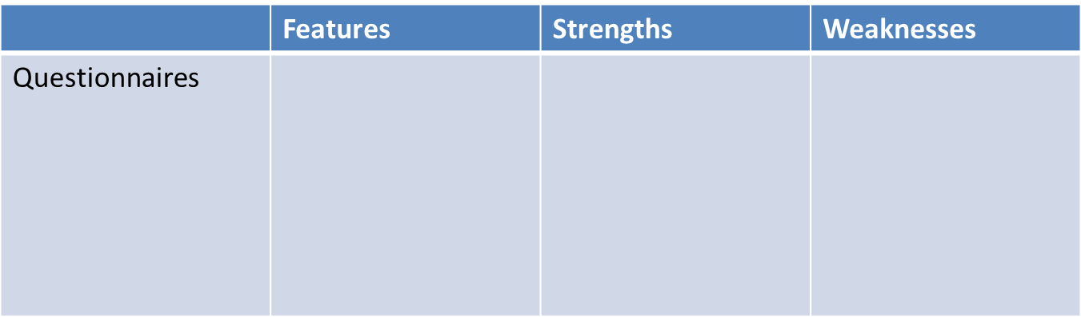
Evaluation of Questionnaires
Describe the features of and evaluate questionnaires
Create unambiguous open and closed questions suitable for questionnaires
Understand why social psychologists make use of questionnaires
Key words:
Likert
Rating
Standardised
Complete parts 2 & 3 of this table for questionnaires
Challenge students:
Try to add another strength and weakness

Slide 47

Plenary
Describe the features of and evaluate questionnaires
Create unambiguous open and closed questions suitable for questionnaires
Understand why social psychologists make use of questionnaires
Key words:
Likert
Rating
Standardised
Noughts and crosses

Slide 48
HOMEWORK
January 2011 Unit 1
Describe the features of and evaluate questionnaires
Create unambiguous open and closed questions suitable for questionnaires
Understand why social psychologists make use of questionnaires
Key words:
Likert
Rating
Standardised

Slide 49

Describe the features of and evaluate questionnaires
Create unambiguous open and closed questions suitable for questionnaires
Understand why social psychologists make use of questionnaires
Key words:
Likert
Rating
Standardised
Read through the checklists for interviews and questionnaires ready for next lesson pg14

Slide 50

Comparing interviews and questionnaires
Identify similarities and differences between questionnaires and interview strengths and weaknesses
Understand issues connected to the designing of surveys
Evaluate surveys in terms of validity, reliability and generalisability
Key words:
Validity
Reliability
Generalisability
Yes, but my bowl’s bigger than yours!
I’m bigger than you!
Lesson 4

Slide 51
Learning objectives
Key words:
Validity
Reliability
Generalisability
Identify similarities and differences between questionnaires and interview features
Identify similarities and differences between questionnaires and interview strengths and weaknesses
Understand issues connected to the designing of surveys
Evaluate surveys in terms of validity, reliability and generalisability

Slide 52


Starter
Identify similarities and differences between questionnaires and interview strengths and weaknesses
Understand issues connected to the designing of surveys
Evaluate surveys in terms of validity, reliability and generalisability
Key words:
Validity
Reliability
Generalisability
Would you rather eat Kangaroo testicles or have all your hair shaved off?

Slide 53
Activity
Identify similarities and differences between questionnaires and interview strengths and weaknesses
Understand issues connected to the designing of surveys
Evaluate surveys in terms of validity, reliability and generalisability
Key words:
Validity
Reliability
Generalisability
Draw a Venn diagram to show similarities and differences between questionnaires and interviews. Work in pairs!

Slide 54
Ideas for your Venn diagram
Identify similarities and differences between questionnaires and interview strengths and weaknesses
Understand issues connected to the designing of surveys
Evaluate surveys in terms of validity, reliability and generalisability
Key words:
Validity
Reliability
Generalisability
Similarities
Both ways of gathering large amount of data
Both fall under the umbrella term of surveys, which mean they are self-report style methods
Both can gather quantitative and qualitative data
Both questionnaires and interviews can be subject to social desirability effect
Differences
Questionnaires make use of open and closed questions whereas Interviews can be structured, semi-structured or unstructured
Questionnaires tend to be written whereas Interviews tend to be face to face
Questionnaires tend to be reliable whereas interviews tend to be valid

Slide 55

Issues of design
Identify similarities and differences between questionnaires and interview strengths and weaknesses
Understand issues connected to the designing of surveys
Evaluate surveys in terms of validity, reliability and generalisability
Key words:
Validity
Reliability
Generalisability
When designing questionnaires and Interviews there are a number of issues to consider:
Wording of the questions
Whether to use questionnaires or Interviews
Whether to ask Open or Closed questions
What size of sample to use
In pairs discuss one of these issues and write down as many points as you can.

Slide 56
Identify similarities and differences between questionnaires and interview strengths and weaknesses
Understand issues connected to the designing of surveys
Evaluate surveys in terms of validity, reliability and generalisability
Key words:
Validity
Reliability
Generalisability
Reliability
This concerns the consistency of the data- if we have a reliable test, we would expect that if we did it over and over again with people who have similar characteristics, we would get similar data. (REplication...REliabilty)

Slide 57
Identify similarities and differences between questionnaires and interview strengths and weaknesses
Understand issues connected to the designing of surveys
Evaluate surveys in terms of validity, reliability and generalisability
Key words:
Validity
Reliability
Generalisability
Validity
Does it measure what it is supposed to measure?
However, we may be wrong in this assumption and in fact it may be something else that causes the behaviour and then our data and conclusions are not valid.

Slide 58
Identify similarities and differences between questionnaires and interview strengths and weaknesses
Understand issues connected to the designing of surveys
Evaluate surveys in terms of validity, reliability and generalisability
Key words:
Validity
Reliability
Generalisability
Subjectivity
We are SUBJECTIVE when we consider something from our own perspective and we are OBJECTIVE when we see what is really there, unaltered by our own biases.

Slide 59
Identify similarities and differences between questionnaires and interview strengths and weaknesses
Understand issues connected to the designing of surveys
Evaluate surveys in terms of validity, reliability and generalisability
Key words:
Validity
Reliability
Generalisability
For each of these terms, summarise their meaning and then think of an example for surveys and put this into your A3 sheet.
RELIABILITY
TEST-RETEST RELIABILITY
SPLIT-HALF RELIABILITY
INTER-RATER RELIABILITY
VALIDITY
FACE VALIDITY
CONTENT VALIDITY
CONCURRENT VALIDITY
PREDICTIVE VALIDITY
ECOLOGICAL VALIDITY
SUBJECTIVITY
Subjective
Objective
Complete this task in pairs.

Slide 60
Identify similarities and differences between questionnaires and interview strengths and weaknesses
Understand issues connected to the designing of surveys
Evaluate surveys in terms of validity, reliability and generalisability
Key words:
Validity
Reliability
Generalisability
Interviews tend to give data with more validity. However they can involve subjectivity and are hard to repeat. It is hard to test for reliability.
Questionnaires are reliable and less likely to involve subjectivity. However, they tend to be less valid, as any open questions may be missed or answered briefly.

Slide 61
Extension task
Identify similarities and differences between questionnaires and interview strengths and weaknesses
Understand issues connected to the designing of surveys
Evaluate surveys in terms of validity, reliability and generalisability
Key words:
Validity
Reliability
Generalisability
question!
Convince me that validity is more of an issue with surveys than reliability.

Slide 62
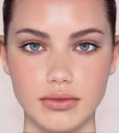

Plenary
Identify similarities and differences between questionnaires and interview strengths and weaknesses
Understand issues connected to the designing of surveys
Evaluate surveys in terms of validity, reliability and generalisability
Key words:
Validity
Reliability
Generalisability
Say what you see!
Face validity

Slide 63

Plenary
Identify similarities and differences between questionnaires and interview strengths and weaknesses
Understand issues connected to the designing of surveys
Evaluate surveys in terms of validity, reliability and generalisability
Key words:
Validity
Reliability
Generalisability
Say what you see!
Inter-rater reliability

Slide 64
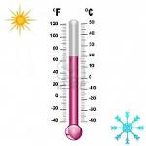

Plenary
Identify similarities and differences between questionnaires and interview strengths and weaknesses
Understand issues connected to the designing of surveys
Evaluate surveys in terms of validity, reliability and generalisability
Key words:
Validity
Reliability
Generalisability
Say what you see!
Predictive validity

Slide 65

Hypothesis
Define different types of hypothesis
Create examples of hypothesis
Compare different types of hypothesis
Key words:
Hypothesis, Experimental, Null, directional, one tailed, two tailed.
Starter!
Where will you be in 5 years time?

Slide 66
What is a hypothesis?
Define different types of hypothesis
Create examples of hypothesis
Compare different types of hypothesis
Key words:
Hypothesis, Experimental, Null, directional, one tailed, two tailed.
PRECISE AND TESTABLE STATEMENT OF THE RELATIONSHIP BETWEEN TWO VARIABLES
A hypothesis is a statement about what is being tested and involves things that are measurable
e.g. older people are more prejudiced than younger people.

Slide 67
IV and DV
Define different types of hypothesis
Create examples of hypothesis
Compare different types of hypothesis
Key words:
Hypothesis, Experimental, Null, directional, one tailed, two tailed.
VARIABLES
Hypotheses are mainly made up of two core variables; the INDEPENDENT VARIABLE is the variable which the experimenter manipulates and The DEPENDENT VARIABLE is the one which the experimenter measures.
Remember this phrase!
IV is MANIPULATED, DV is MEASURED!

Slide 68
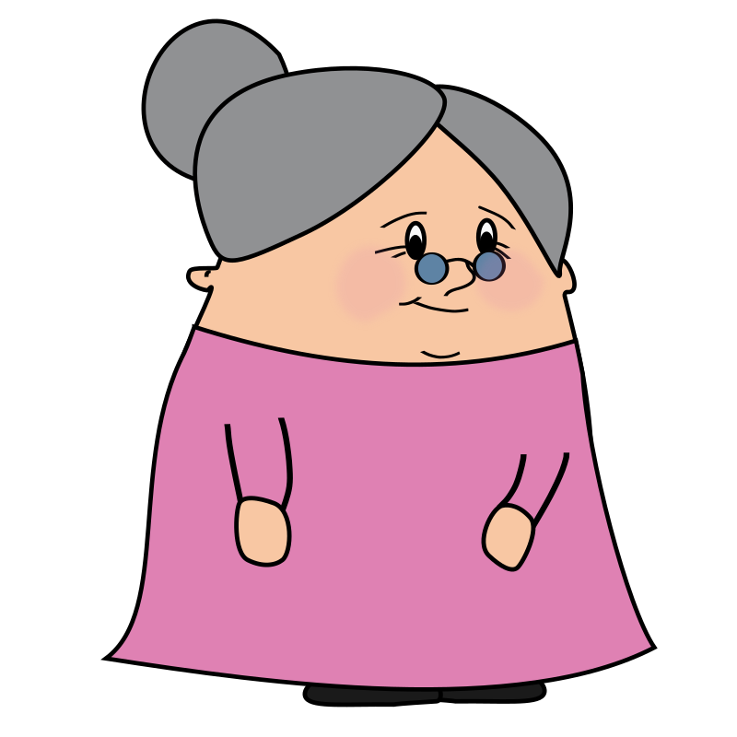

Define different types of hypothesis
Create examples of hypothesis
Compare different types of hypothesis
Key words:
Hypothesis, Experimental, Null, directional, one tailed, two tailed.
Remember this phrase!
IV is MANIPULATED, DV is MEASURED!
Ivy is an elderly lady is often manipulated by her grandchildren!

Slide 69
OPERATIONALISE VARIABLES
Define different types of hypothesis
Create examples of hypothesis
Compare different types of hypothesis
Key words:
Hypothesis, Experimental, Null, directional, one tailed, two tailed.
Psychologists use the term “operationalise” to describe the fact that a hypothesis is highly specific. OPERATIONALISE means spelling out the various operations. In other words you narrow the topic area down in order to measure it accurately. For example, the concept of a young child was operationalised as “a child under the age of seven” OR a cognitive task as specified as “the conservation of volume”.

Slide 70
Alternate / Experimental hypothesis
Define different types of hypothesis
Create examples of hypothesis
Compare different types of hypothesis
Key words:
Hypothesis, Experimental, Null, directional, one tailed, two tailed.
Surveys are planned as an aim and from this a hypothesis is created. In statistics, an alternative to the null hypothesis typically asserts that the independent variable has an effect on the dependent variable that cannot be explained by chance alone. The experimental hypothesis is sometimes referred to as the ALTERNATIVE HYPOTHESIS. Remember that some studies are not experiments (they may be observations, interviews etc.) and in this case we do not start with an experimental hypothesis but with an alternative hypothesis. When we carry out an experiment we can use either term.

Slide 71
Null hypothesis
Define different types of hypothesis
Create examples of hypothesis
Compare different types of hypothesis
Key words:
Hypothesis, Experimental, Null, directional, one tailed, two tailed.
The null hypothesis is therefore the opposite of the experimental (alternative) hypothesis and our results allow us to choose between the two, and therefore to decide which one we can REJECT. If there really is a significant difference between the Monday morning scores and the Friday afternoon scores then we reject the null hypothesis. If there is no significant difference, then we reject the experimental (alternative) hypothesis.
We refer to which hypothesis we REJECT – e.g.
If there IS a significant difference then we reject the null and accept the alternate hypothesis.
If there is NO significant difference then we reject the alternate hypothesis and accept the null hypothesis.

Slide 72
Define different types of hypothesis
Create examples of hypothesis
Compare different types of hypothesis
Key words:
Hypothesis, Experimental, Null, directional, one tailed, two tailed.
The EXPERIMENTAL HYPOTHESIS states that there will be a significant increase in older people obeying and queuing at a bank than younger people.
AND
The NULL HYPOTHESIS states that there will be no significant difference in older people obeying and queuing at a bank than younger people.

Slide 73
‘Significant’
Define different types of hypothesis
Create examples of hypothesis
Compare different types of hypothesis
Key words:
Hypothesis, Experimental, Null, directional, one tailed, two tailed.
The word SIGNIFICANT keeps coming up in relation to differences in the scores. This is a very important word and must NOT be left out when you write hypotheses for your work.

Slide 74
Task time, Pg 22
Define different types of hypothesis
Create examples of hypothesis
Compare different types of hypothesis
Key words:
Hypothesis, Experimental, Null, directional, one tailed, two tailed.
Read the following statements, identify the IV and DV in each and fully operationalise them.
Remember operationalise means to narrow down a term, concept or idea so that you can measure it. So you must be clear and precise in what your IV is causing and you DV is measuring.

Slide 75
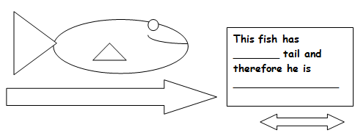
Directional and non directional hypothesis
Define different types of hypothesis
Create examples of hypothesis
Compare different types of hypothesis
Key words:
Hypothesis, Experimental, Null, directional, one tailed, two tailed.
DIRECTIONAL HYPOTHESES or ONE-TAILED:
STATES THE KIND OF DIFFERENCE OR RELATIONSHIP BETWEEN THE TWO CONDITIONS OR TWO GROUPS OF PARTICIPANTS.

Slide 76
Directional hypothesis
Define different types of hypothesis
Create examples of hypothesis
Compare different types of hypothesis
Key words:
Hypothesis, Experimental, Null, directional, one tailed, two tailed.
DIRECTIONAL HYPOTHESES or ONE-TAILED:
STATES THE KIND OF DIFFERENCE OR RELATIONSHIP BETWEEN THE TWO CONDITIONS OR TWO GROUPS OF PARTICIPANTS.
E.g. The faster you drive the more likely you are to crash

Slide 77
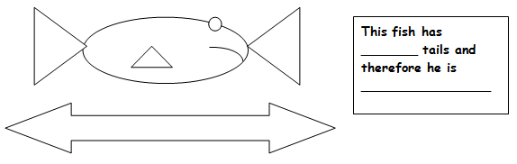
Directional and non directional hypothesis
Define different types of hypothesis
Create examples of hypothesis
Compare different types of hypothesis
Key words:
Hypothesis, Experimental, Null, directional, one tailed, two tailed.
NON-DIRECTIONAL HYPOTHESES or TWO-TAILED:
PREDICTS THAT THERE WILL BE A DIFFERENCE OR RELATIONSHIP BETWEEN TWO CONDITIONS OR TWO GROUPS OF PARTICIPANTS

Slide 78
Non directional hypothesis
Define different types of hypothesis
Create examples of hypothesis
Compare different types of hypothesis
Key words:
Hypothesis, Experimental, Null, directional, one tailed, two tailed.
NON-DIRECTIONAL HYPOTHESES or TWO-TAILED:
PREDICTS THAT THERE WILL BE A DIFFERENCE OR RELATIONSHIP BETWEEN TWO CONDITIONS OR TWO GROUPS OF PARTICIPANTS
E.g. There will be a significant difference between the obedience levels of boys and girls.

Slide 79
Null hypothesis
Define different types of hypothesis
Create examples of hypothesis
Compare different types of hypothesis
Key words:
Hypothesis, Experimental, Null, directional, one tailed, two tailed.
NULL HYPOTHESES:
A null hypothesis also needs to be stated about the study.
A NULL HYPOTHESIS IS A STATEMENT OF NO DIFFERENCE OR NO RELATIONSHIP BETWEEN THE VARIABLES.
e.g. “There will be no significant difference in driving between those who have stayed awake and those who have not slept. Any difference will be due to chance or some other factor.

Slide 80
Task time!
Define different types of hypothesis
Create examples of hypothesis
Compare different types of hypothesis
Key words:
Hypothesis, Experimental, Null, directional, one tailed, two tailed.
Complete the tasks starting on page 25 of your booklets.

Slide 81
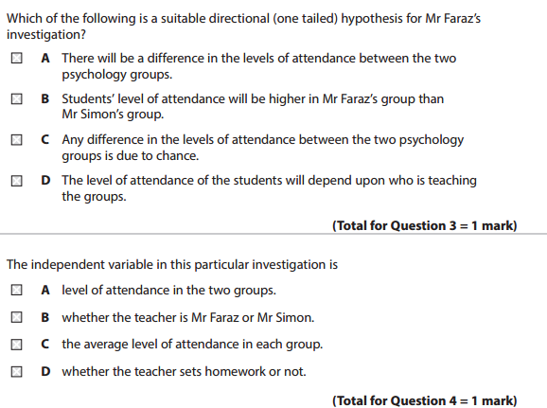
Define different types of hypothesis
Create examples of hypothesis
Compare different types of hypothesis
Key words:
Hypothesis, Experimental, Null, directional, one tailed, two tailed.
Mr Faraz wants to compare the levels of attendance between his psychology group and those of Mr Simon, who teaches a different psychology group.
June 2015

Slide 82
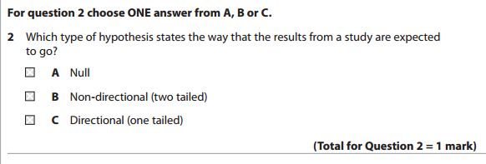
Define different types of hypothesis
Create examples of hypothesis
Compare different types of hypothesis
Key words:
Hypothesis, Experimental, Null, directional, one tailed, two tailed.
June 2013

Slide 83
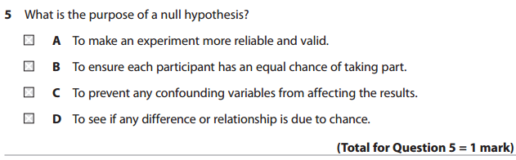
Define different types of hypothesis
Create examples of hypothesis
Compare different types of hypothesis
Key words:
Hypothesis, Experimental, Null, directional, one tailed, two tailed.

Slide 84
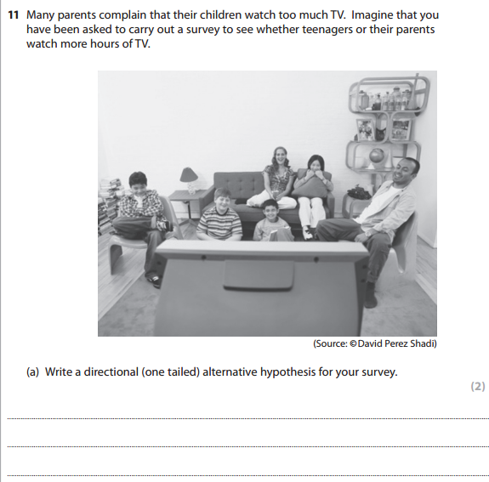
Define different types of hypothesis
Create examples of hypothesis
Compare different types of hypothesis
Key words:
Hypothesis, Experimental, Null, directional, one tailed, two tailed.
June 2013

Slide 85
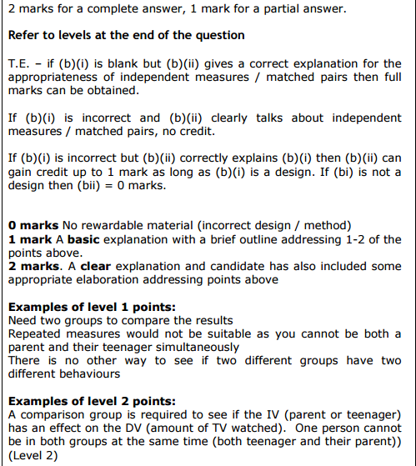
Define different types of hypothesis
Create examples of hypothesis
Compare different types of hypothesis
Key words:
Hypothesis, Experimental, Null, directional, one tailed, two tailed.
June 2013

Slide 86
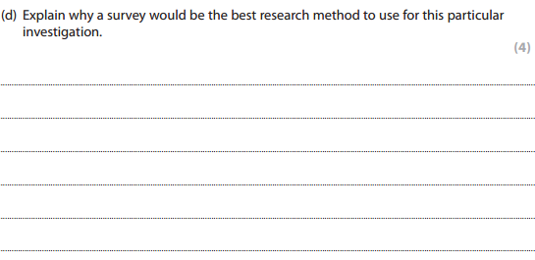
Define different types of hypothesis
Create examples of hypothesis
Compare different types of hypothesis
Key words:
Hypothesis, Experimental, Null, directional, one tailed, two tailed.
June 2013

Slide 87
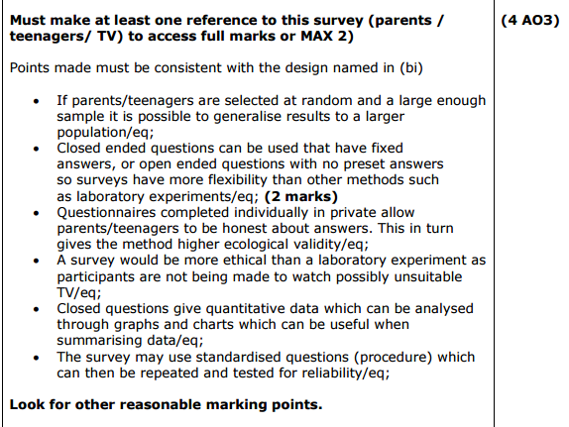
Define different types of hypothesis
Create examples of hypothesis
Compare different types of hypothesis
Key words:
Hypothesis, Experimental, Null, directional, one tailed, two tailed.
June 2013

Slide 88

Ethical Issues in Social Psychology
Describe 5 ethical issues in psychological research
Identify examples of ethical issues that may arise when conducting interviews or questionnaires
Suggest ways of dealing with ethical issues when carrying our either an interview or questionnaire
Key words:
Deception
Distress
Ethics

Slide 89


Starter
Describe 5 ethical issues in psychological research
Identify examples of ethical issues that may arise when conducting interviews or questionnaires
Suggest ways of dealing with ethical issues when carrying our either an interview or questionnaire
Key words:
Deception
Distress
Ethics
Say what you see!

Slide 90

Starter
Describe 5 ethical issues in psychological research
Identify examples of ethical issues that may arise when conducting interviews or questionnaires
Suggest ways of dealing with ethical issues when carrying our either an interview or questionnaire
Key words:
Deception
Distress
Ethics
Say what you see!

Slide 91
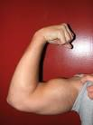

Describe 5 ethical issues in psychological research
Identify examples of ethical issues that may arise when conducting interviews or questionnaires
Suggest ways of dealing with ethical issues when carrying our either an interview or questionnaire
Key words:
Deception
Distress
Ethics
Say what you see!

Slide 92
Learning objectives
Key words:
Deception
Distress
Ethics
Describe 5 ethical issues in psychological research
Identify examples of ethical issues that may arise when conducting interviews or questionnaires
Suggest ways of dealing with ethical issues when carrying our either an interview or questionnaire

Slide 93
Describe 5 ethical issues in psychological research
Identify examples of ethical issues that may arise when conducting interviews or questionnaires
Suggest ways of dealing with ethical issues when carrying our either an interview or questionnaire
Key words:
Deception
Distress
Ethics
In the UK, psychological research is monitored by the British Psychological Society (BPS). The ethical guidelines that have been created aim to protect participants, and they must be followed when conducting research.

Slide 94
Describe 5 ethical issues in psychological research
Identify examples of ethical issues that may arise when conducting interviews or questionnaires
Suggest ways of dealing with ethical issues when carrying our either an interview or questionnaire
Key words:
Deception
Distress
Ethics
CONSENT
Psychologists carrying out investigations or inventions should always obtain the valid consent of the participants, ensuring that they can make an informed decision about the nature of their contributions and its potential consequences.. Research should give informed consent which tells those involved about the true aim of the research but this means that the results may not always be completely valid, it quite often depends on the topic of research what type of consent is required.
EXAMPLES – PILIAVIN subway study involved subjects not asked for their consent at all. ZIMBARDO got his participants to sign a formal “informed consent” statement specifying there would be a loss of some civil rights, invasion of privacy and harassment.

Slide 95
Describe 5 ethical issues in psychological research
Identify examples of ethical issues that may arise when conducting interviews or questionnaires
Suggest ways of dealing with ethical issues when carrying our either an interview or questionnaire
Key words:
Deception
Distress
Ethics
DECEPTION
Guidelines state that participants should not be deliberately misled without extremely strong scientific or medical justification. When it is allowed there should be strict controls over the entire procedure and write-up. Many psychological studies would not have received the results they did if they did not employ deception and so a cost-benefit analysis of the gains versus the discomfort of the participant must be considered.
EXAMPLE – MILGRAM directly deceived his subjects into believing that they were doing research on learning when it was obedience, however he justified this by saying that according to predictions the results would not have been as realistic.

Slide 96
Describe 5 ethical issues in psychological research
Identify examples of ethical issues that may arise when conducting interviews or questionnaires
Suggest ways of dealing with ethical issues when carrying our either an interview or questionnaire
Key words:
Deception
Distress
Ethics
RIGHT TO WITHDRAW
Any participant in a psychological study should be informed that they have the right to withdraw from the testing when ever they wish and that afterwards they have the right to withdraw their results if they wish to.
EXAMPLES – MILGRAM (1963) has been accused of not offering his participants the right to withdraw and were told using prods that they had no choice but to continue however, Milgram stated that they were not physically restrained and could have left at any time. In ZIMBARDO’S (1973) study he actually withdrew his subjects after only 6 days because of the distress and disturbing results that were being shown.

Slide 97
Describe 5 ethical issues in psychological research
Identify examples of ethical issues that may arise when conducting interviews or questionnaires
Suggest ways of dealing with ethical issues when carrying our either an interview or questionnaire
Key words:
Deception
Distress
Ethics
DEBRIEFING OF PARTICIPANTS
At the end of the study participants must be fully debriefed which can include informing them of the true aim and full extent of what went on. During this the researcher must insure that all participants leave in the same mind as they arrived and that they have not come to any psychological harm during the research.
EXAMPLES – MILGRAM (1963) study was excellent for debriefing, they met the learner after and shown that he was not hurt, they were interviewed after also and up to a year later to check they were all right.

Slide 98
Describe 5 ethical issues in psychological research
Identify examples of ethical issues that may arise when conducting interviews or questionnaires
Suggest ways of dealing with ethical issues when carrying our either an interview or questionnaire
Key words:
Deception
Distress
Ethics
COMPETENCE AND CONDUCT
The personal conduct of psychologist should not be damaged and the recipients of their services or participants in their research. Nor should their conduct undermine public confidence in their own ability or in that of other psychologists or members of related professions, they should refrain from participating in work that would harm individuals, should not accept payment, nor exploit trust, maintain professional standards, value others opinions, not claim credit for others work, ensure safety and act responsibly.

Slide 99
Describe 5 ethical issues in psychological research
Identify examples of ethical issues that may arise when conducting interviews or questionnaires
Suggest ways of dealing with ethical issues when carrying our either an interview or questionnaire
Key words:
Deception
Distress
Ethics
CONFIDENTAILITY
It is essential that details about those involved are kept confidential in order to protect them, their identity should not be revealed except with their expressed permission.
EXAMPLES- MILGRAM (1963) had partial confidentiality - he did not give out names but did disclose the area his participants were from.

Slide 100
Describe 5 ethical issues in psychological research
Identify examples of ethical issues that may arise when conducting interviews or questionnaires
Suggest ways of dealing with ethical issues when carrying our either an interview or questionnaire
Key words:
Deception
Distress
Ethics
PROTECTION
Participants should be protected from harm, including stress. This means that they should not be exposed to more risks than they would normally encounter in their usual lifestyle.
OBSERVATION
Observational studies risk breaching privacy. In observations when participants are unaware they are being observed they should only be observed in places and situations where they would expect people to observe them.

Slide 101
Describe 5 ethical issues in psychological research
Identify examples of ethical issues that may arise when conducting interviews or questionnaires
Suggest ways of dealing with ethical issues when carrying our either an interview or questionnaire
Key words:
Deception
Distress
Ethics
ADVICE
If a researcher sees signs of a physical or psychological problem the participant is unaware of, but which might threaten their future well-being, they should inform them. Where participants seek professional advice the researchers should be cautious.
COLLEAGUES
Where colleagues are conducting research that falls foul of one or more of the above principles, it is important to inform them and to try and persuade them to alter their conduct.

Slide 102
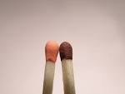
Activity
Describe 5 ethical issues in psychological research
Identify examples of ethical issues that may arise when conducting interviews or questionnaires
Suggest ways of dealing with ethical issues when carrying our either an interview or questionnaire
Key words:
Deception
Distress
Ethics
Look at the following brief descriptions of studies. Decide which you think are real and which are fake. What are the ethical principles that these studies violate?

Slide 103

Application of learning
Describe 5 ethical issues in psychological research
Identify examples of ethical issues that may arise when conducting interviews or questionnaires
Suggest ways of dealing with ethical issues when carrying our either an interview or questionnaire
Key words:
Deception
Distress
Ethics
Which ethical issues would you need to consider if you were doing a survey.
Using the summary table provided, suggest issues for each method and justify your reasons.

Slide 104
Solutions!
Describe 5 ethical issues in psychological research
Identify examples of ethical issues that may arise when conducting interviews or questionnaires
Suggest ways of dealing with ethical issues when carrying our either an interview or questionnaire
Key words:
Deception
Distress
Ethics
Avoiding ethical issues when conducting surveys

Slide 105

Extension task
Describe 5 ethical issues in psychological research
Identify examples of ethical issues that may arise when conducting interviews or questionnaires
Suggest ways of dealing with ethical issues when carrying our either an interview or questionnaire
Key words:
Deception
Distress
Ethics
Question
Convince me that surveys are more ethical than laboratory experiments.

Slide 106
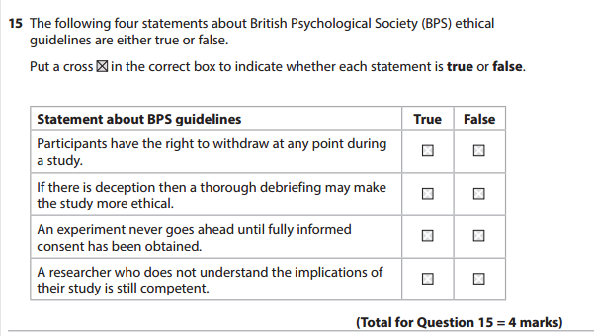
Describe 5 ethical issues in psychological research
Identify examples of ethical issues that may arise when conducting interviews or questionnaires
Suggest ways of dealing with ethical issues when carrying our either an interview or questionnaire
Key words:
Deception
Distress
Ethics
June 2015

Slide 107
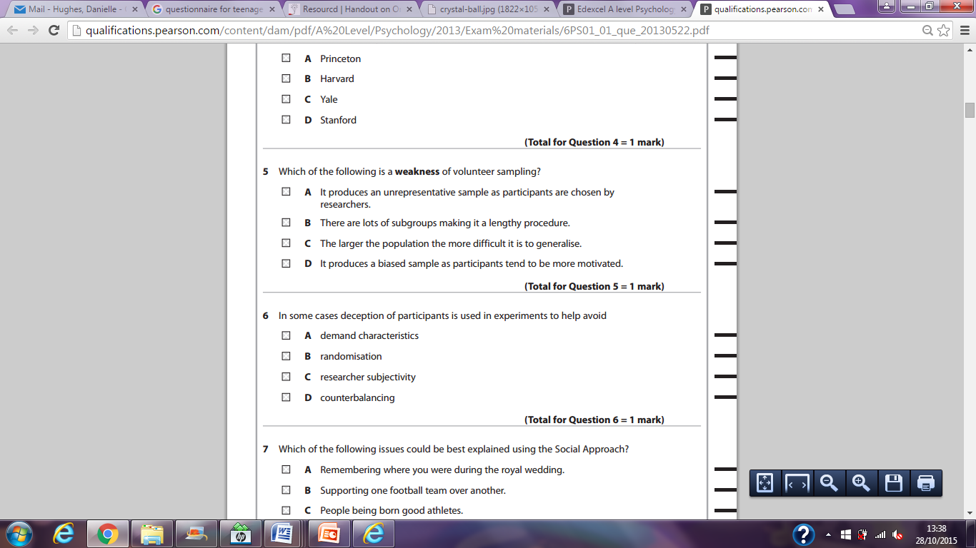
Describe 5 ethical issues in psychological research
Identify examples of ethical issues that may arise when conducting interviews or questionnaires
Suggest ways of dealing with ethical issues when carrying our either an interview or questionnaire
Key words:
Deception
Distress
Ethics

Slide 108
Plenary
Describe 5 ethical issues in psychological research
Identify examples of ethical issues that may arise when conducting interviews or questionnaires
Suggest ways of dealing with ethical issues when carrying our either an interview or questionnaire
Key words:
Deception
Distress
Ethics
Make up a mnemonic for the 5 ethical issues you have to learn for Psychology.
Confidentiality
Protection
Deception
Consent
Withdraw
There’s a prize for the silliest one!

Slide 109
Sampling
Identify the different types of sampling
Compare the sampling techniques
Evaluate the sampling techniques in terms of strengths and weaknesses
Key words:
Stratified
Opportunity

Slide 110
Identify the different types of sampling
Compare the sampling techniques
Evaluate the sampling techniques in terms of strengths and weaknesses
Key words:
Stratified
Opportunity
Choosing a target population
How do you decide which participants take part in your study (sample)? Furthermore how do you decide on your sample size?
The first step is to decide who your target population is. The sample should be representative of the target population so that results can be generalised. If the sample is not representative of the target population then it is biased.
Sampling is key when judging the external validity, particularly population validity. We will consider random, stratified opportunity and volunteer sampling.

Slide 111
Identify the different types of sampling
Compare the sampling techniques
Evaluate the sampling techniques in terms of strengths and weaknesses
Key words:
Stratified
Opportunity
Random sampling
Truly random sampling only occurs when every member of the target population has an equal chance of being selected. Each individual is chosen entirely by chance and each member of the population has a known, but possibly non-equal, chance of being included in the sample. For example, putting names of every member of the target population into a hat and pulling a sample out (without looking).

Slide 112
RANDOM
Identify the different types of sampling
Compare the sampling techniques
Evaluate the sampling techniques in terms of strengths and weaknesses
Key words:
Stratified
Opportunity
Strength
Likely to be unbiased as the researcher does not control who is chosen
Weakness
Very hard to do unless you have only a small population

Slide 113
Identify the different types of sampling
Compare the sampling techniques
Evaluate the sampling techniques in terms of strengths and weaknesses
Key words:
Stratified
Opportunity
Stratified sampling
Involves dividing the target population into important subcategories (or strata) and then selecting members of these subcategorise in the proportion that they occur in the target population. For example, if a target population consisted of 75% women and 25% men, a sample of 20 should include 15 women and 5 men. For example, suppose a farmer wishes to work out the average milk yield of each cow type in his herd which consists of Ayrshire, Friesian, Galloway and Jersey cows. He could divide up his herd into the four sub-groups and take samples from these.

Slide 114
STRATIFIED
Identify the different types of sampling
Compare the sampling techniques
Evaluate the sampling techniques in terms of strengths and weaknesses
Key words:
Stratified
Opportunity
Strength
Likely to be very representative of the population if done properly
Weakness
Likely to be very time consuming and difficult

Slide 115
Identify the different types of sampling
Compare the sampling techniques
Evaluate the sampling techniques in terms of strengths and weaknesses
Key words:
Stratified
Opportunity
Opportunity sampling
Simply involves selecting those subjects that are around and available at the time, an effort may be made to not be biased in selecting particular types of subject. This may simply consist of choosing the first 20 students in your college canteen to fill in your questionnaire. For example, university psychologists may sample from their own students.

Slide 116
OPPORTUNITY
Identify the different types of sampling
Compare the sampling techniques
Evaluate the sampling techniques in terms of strengths and weaknesses
Key words:
Stratified
Opportunity
Strength
Really easy and quick. Likely to be ethical
Weakness
Probably not very representative, as drawn from only a small section of the community

Slide 117
Identify the different types of sampling
Compare the sampling techniques
Evaluate the sampling techniques in terms of strengths and weaknesses
Key words:
Stratified
Opportunity
Volunteer sampling
Consist of those individuals who have consciously or unconsciously determined their own involvement in society, in other words they volunteer. For example, studies or passers by who become involved in field studies ie, in bystander intervention studies.

Slide 118
VOLUNTEER OR SELF-SELECTING
Identify the different types of sampling
Compare the sampling techniques
Evaluate the sampling techniques in terms of strengths and weaknesses
Key words:
Stratified
Opportunity
Strength
Will probably access a variety of people you would not have normally had access to and they are likely to be motivated
Weakness
Motivation may make them behave differently. Volunteers may have special qualities.

Slide 119
Identify the different types of sampling
Compare the sampling techniques
Evaluate the sampling techniques in terms of strengths and weaknesses
Key words:
Stratified
Opportunity

Slide 120
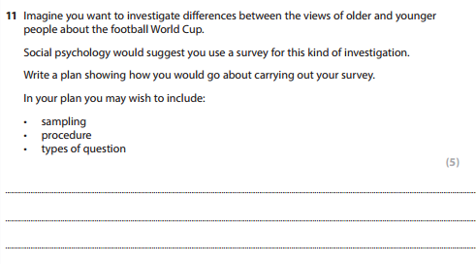
Identify the different types of sampling
Compare the sampling techniques
Evaluate the sampling techniques in terms of strengths and weaknesses
Key words:
Stratified
Opportunity
June 2014

Slide 121
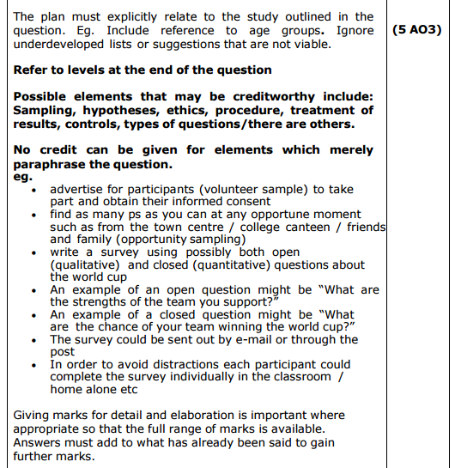
Identify the different types of sampling
Compare the sampling techniques
Evaluate the sampling techniques in terms of strengths and weaknesses
Key words:
Stratified
Opportunity
June 2014

Slide 122
Examination style questions
Describe and evaluate the interview as a research method in psychology (12 marks).
Outline 3 ethical guidelines and assess two of the guidelines you have chosen (12 marks).
Outline 1 advantage and 1 disadvantage of 2 sampling methods used in psychology.
Extension questions
Compare the use of questionnaires and interviews as research methods in psychology (10 marks).
Discuss why ethical guidelines are necessary for research (12marks).
Compare 3 different methods of sampling used in psychology (9 marks).

Slide 123
Identify the measures of central tendency
Calculate different measures of central tendency
Evaluate the strengths and weaknesses of each measure
Key words:
Central tendency
Dispersion
Measures of central tendency!
Starter-
How many measures of central tendency can you remember from GCSE maths?

Slide 124
Identify the measures of central tendency
Calculate different measures of central tendency
Evaluate the strengths and weaknesses of each measure
Key words:
Central tendency
Dispersion
Mode – the most frequently occurring value
Median – the middle value when scores are arranged in descending order
Mean – the arithmetic average (add up all scores and divide by the number of scores)

Slide 125
Averages (The Mode)
The mode is the data value that occurs most frequently
Example 1. The number of matches in a random sample of 14 boxes were counted and the results are recorded below. Find the mode of the data.
48, 49, 52, 50, 51, 49, 49, 55, 47, 48, 50, 51, 50, 50,
Mode = 50 (as it occurs more often than the other numbers).

Slide 126
Averages (The Mode)
The mode is the data value that occurs most frequently
Example 2. Twenty people sat a maths test. Their marks out of 10 are recorded below. Find the modal mark for the test.
2, 5, 9, 3, 7, 6, 8, 6, 10, 4,
3, 2, 0, 9, 5, 1, 8, 6, 1, 5
Mode = 5 and 6

Slide 127
Averages (The Median)
The median is the middle value of a set of data once the data has been ordered.
Example 1. Robert hit 11 balls at Grimsby driving range. The recorded distances of his drives, measured in yards, are given below. Find the median distance for his drives.
85, 125, 130, 65, 100, 70, 75, 50, 140, 95, 70
50, 65, 70, 70, 75, 85, 95, 100, 125, 130, 140
Single middle value
Ordered data
Median drive = 85 yards

Slide 128
Averages (The Median)
The median is the middle value of a set of data once the data has been ordered.
Example 1. Robert hit 12 balls at Grimsby driving range. The recorded distances of his drives, measured in yards, are given below. Find the median distance for his drives.
85, 125, 130, 65, 100, 70, 75, 50, 140, 135, 95, 70
50, 65, 70, 70, 75, 85, 95, 100, 125, 130, 135, 140
Two middle values so take the mean.
Ordered data
Median drive = 90 yards

Slide 129

Hey diddle diddle the median’s the middle, you add and divide for the mean.
The mode is the one that you see the most and the range is the difference between.

Slide 130
Identify the measures of central tendency
Calculate different measures of central tendency
Evaluate the strengths and weaknesses of each measure
Key words:
Central tendency
Dispersion
Complete the questions on pg 35 of your research methods booklet.
If you did this over half term, complete the extension sheet.

Slide 131
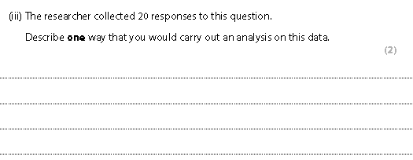
Identify the measures of central tendency
Calculate different measures of central tendency
Evaluate the strengths and weaknesses of each measure
Key words:
Central tendency
Dispersion
SAMS- Sample assessment materials

Slide 132
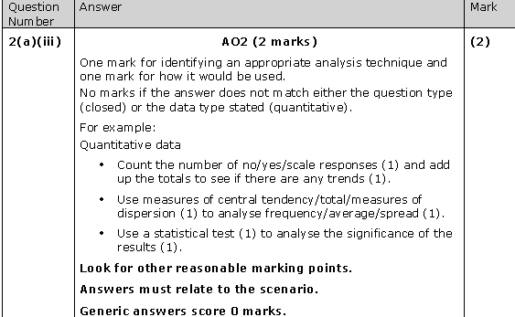
Identify the measures of central tendency
Calculate different measures of central tendency
Evaluate the strengths and weaknesses of each measure
Key words:
Central tendency
Dispersion
SAMS- Sample assessment materials

Slide 133
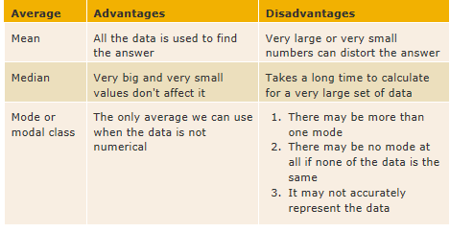
Identify the measures of central tendency
Calculate different measures of central tendency
Evaluate the strengths and weaknesses of each measure
Key words:
Central tendency
Dispersion
What are the advantages and disadvantages of
each of these measures of central tendency?

Slide 134
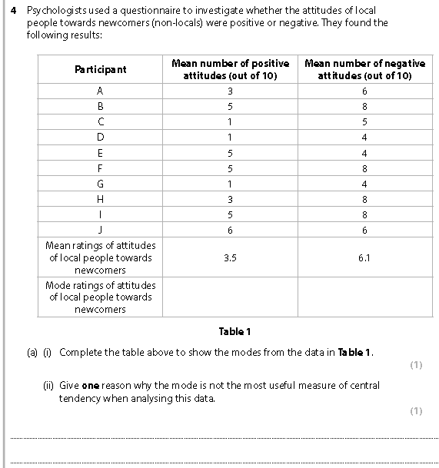
Identify the measures of central tendency
Calculate different measures of central tendency
Evaluate the strengths and weaknesses of each measure
Key words:
Central tendency
Dispersion
SAMS- Sample assessment materials

Slide 135
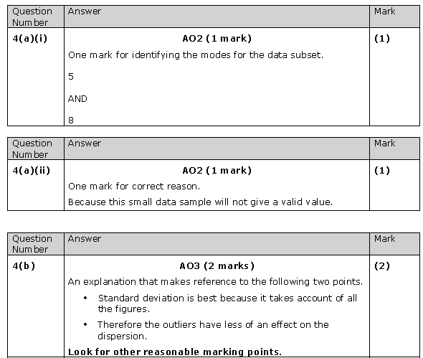
Identify the measures of central tendency
Calculate different measures of central tendency
Evaluate the strengths and weaknesses of each measure
Key words:
Central tendency
Dispersion
SAMS- Sample assessment materials

Slide 136
Identify the measures of dispersion
Calculate different measures of dispersion
Evaluate the strengths and weaknesses of each measure
Key words:
Central tendency
Dispersion
Measures of dispersion!
These examine variability in data sets. They help us understand whether scores in a data set are very similar or very different. In other words how spread out scores are.

Slide 137
Identify the measures of dispersion
Calculate different measures of dispersion
Evaluate the strengths and weaknesses of each measure
Key words:
Central tendency
Dispersion
Measures of dispersion!
Range – This is the simplest measure of dispersion. It tells us over how many numbers a distribution is spread. It is the difference between the highest and the lowest score + 1.

Slide 138
Identify the measures of dispersion
Calculate different measures of dispersion
Evaluate the strengths and weaknesses of each measure
Key words:
Central tendency
Dispersion
Measures of dispersion! Range
The problem with this is that extreme values affect the result.
e.g.
10 11 11 12 12 13 13 13 14
10 11 11 12 12 13 13 13 20
One single figure changes the range from 5 to 11.
Calculate the range for the following data sets and comment on what it tells us.
12 10 8 4 18 8
0 0 4 5 20 22 19
0 19 21 18 22
2 3 3 3 4 4 4 4 5 5 5 6

Slide 139
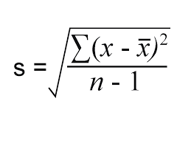
Identify the measures of dispersion
Calculate different measures of dispersion
Evaluate the strengths and weaknesses of each measure
Key words:
Central tendency
Dispersion
Measures of dispersion!
Standard deviation!
This is a much more useful measure of dispersion, as it tells us how far, on average, each score is from the mean. The smaller the standard deviation the more scores are clustered around the mean, the larger the standard deviation is the more spread out are the scores.

Slide 140
Identify the measures of dispersion
Calculate different measures of dispersion
Evaluate the strengths and weaknesses of each measure
Key words:
Central tendency
Dispersion
Measures of dispersion!
Standard deviation!
If you have the mean YOU ALWAYS do a standard deviation because you are calculating how far away from the mean the scores are!

Slide 141
Identify the measures of dispersion
Calculate different measures of dispersion
Evaluate the strengths and weaknesses of each measure
Key words:
Central tendency
Dispersion
Measures of dispersion!
Standard deviation!
The bigger the standard deviation the more variation there is in the data. The more spread out the scores are.
x
x
If mean was 5 this would be a small SD
x
0
5
10
x
x
If mean was 5 this would be a large SD
5
10
0

Slide 142
Identify the measures of dispersion
Calculate different measures of dispersion
Evaluate the strengths and weaknesses of each measure
Key words:
Central tendency
Dispersion
Measures of dispersion!
Standard deviation!
The formula!
You will be given the formula but need to know how to use it.
You will often be given a table with gaps in for you to calculate or substitute gaps in to.

Slide 143

Identify the measures of dispersion
Calculate different measures of dispersion
Evaluate the strengths and weaknesses of each measure
Key words:
Central tendency
Dispersion
Measures of dispersion!
Standard deviation!
The formula! You need to know.....
Sigma
Means the sum of
Means raw score
Means the mean
Number of p’pants

Slide 144
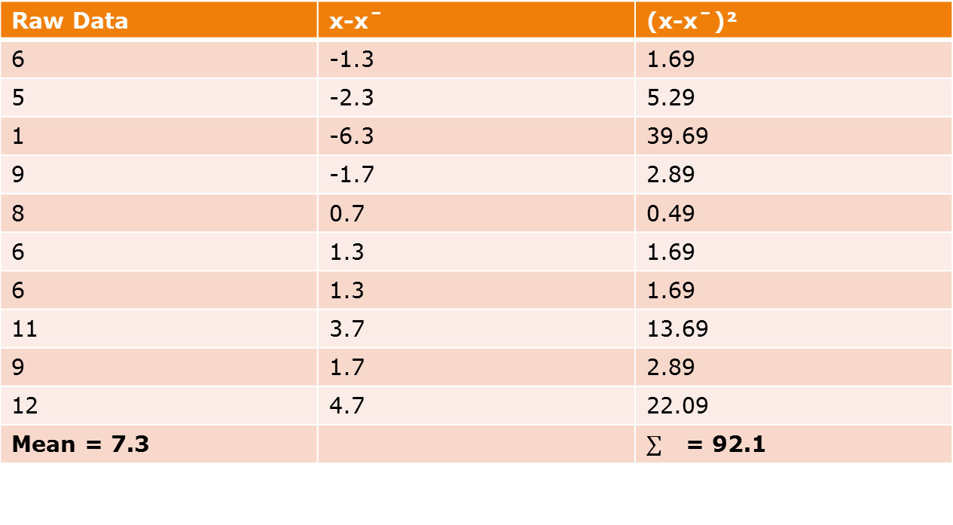
Identify the measures of dispersion
Calculate different measures of dispersion
Evaluate the strengths and weaknesses of each measure
Key words:
Central tendency
Dispersion
Step 1 – Calculate the mean
Raw Data | x-xˉ | (x-xˉ)²
6
5
1
9
8
6
6
11
9
12
Mean = 7.3

Slide 145
Identify the measures of dispersion
Calculate different measures of dispersion
Evaluate the strengths and weaknesses of each measure
Key words:
Central tendency
Dispersion
Step 2 – x – x = raw data – the mean
Raw Data | x-xˉ | (x-xˉ)²
6
5
1
9
8
6
6
11
9
12
Mean = 7.3

Slide 146
Identify the measures of dispersion
Calculate different measures of dispersion
Evaluate the strengths and weaknesses of each measure
Key words:
Central tendency
Dispersion
Step 2 – x – x = raw data – the mean
Raw Data | x-xˉ | (x-xˉ)²
6 | -1.3
5 | -2.3
1 | -6.3
9 | -1.7
8 | 0.7
6 | 1.3
6 | 1.3
11 | 3.7
9 | 1.7
12 | 4.7
Mean = 7.3

Slide 147
Identify the measures of dispersion
Calculate different measures of dispersion
Evaluate the strengths and weaknesses of each measure
Key words:
Central tendency
Dispersion
Step 3 (x – x ) ² = column 2 squared
Raw Data | x-xˉ | (x-xˉ)²
6 | -1.3
5 | -2.3
1 | -6.3
9 | -1.7
8 | 0.7
6 | 1.3
6 | 1.3
11 | 3.7
9 | 1.7
12 | 4.7
Mean = 7.3

Slide 148
Identify the measures of dispersion
Calculate different measures of dispersion
Evaluate the strengths and weaknesses of each measure
Key words:
Central tendency
Dispersion
Step 3 (x – x ) ² = column 2 squared
Raw Data | x-xˉ | (x-xˉ)²
6 | -1.3 | 1.69
5 | -2.3 | 5.29
1 | -6.3 | 39.69
9 | -1.7 | 2.89
8 | 0.7 | 0.49
6 | 1.3 | 1.69
6 | 1.3 | 1.69
11 | 3.7 | 13.69
9 | 1.7 | 2.89
12 | 4.7 | 22.09
Mean = 7.3

Slide 149
Identify the measures of dispersion
Calculate different measures of dispersion
Evaluate the strengths and weaknesses of each measure
Key words:
Central tendency
Dispersion
Step 4 ∑ = sum of. Add them all together
Raw Data | x-xˉ | (x-xˉ)²
6 | -1.3 | 1.69
5 | -2.3 | 5.29
1 | -6.3 | 39.69
9 | -1.7 | 2.89
8 | 0.7 | 0.49
6 | 1.3 | 1.69
6 | 1.3 | 1.69
11 | 3.7 | 13.69
9 | 1.7 | 2.89
12 | 4.7 | 22.09
Mean = 7.3

Slide 150
Identify the measures of dispersion
Calculate different measures of dispersion
Evaluate the strengths and weaknesses of each measure
Key words:
Central tendency
Dispersion
Step 5 = n - 1
Number of participants was 10
10 – 1 = 9
92.1 ÷ 9 = 10.233

Slide 151
Identify the measures of dispersion
Calculate different measures of dispersion
Evaluate the strengths and weaknesses of each measure
Key words:
Central tendency
Dispersion
Step 6 = square root of the answer
√10.233 = 3.2

Slide 152
Standard Deviation
We will introduce the idea standard deviation by first considering the table below. This table is a sample of the marks from five students that sat the same test in three different classes.
Class |  |  |  |  |  | Mean ( x ) | Range
A | 80 | 80 | 80 | 40 | 40 | 64 | 40
B | 80 | 76 | 68 | 56 | 40 | 64 | 40
C | 65 | 64 | 64 | 64 | 63 | 64 | 2
Sample Marks Scored in Test
Each class had a mean mark of 64 but the spread/dispersion/variation of marks show large differences.
The range gives a poor measure of variation in this example.
Classes A and B have the same range but none of the marks in class A are close to the mean, whereas some of the marks in class B are. In class C all of the marks are close to the mean.
It is this concept of “Closeness to the mean” that leads to the definition of standard deviation.

Slide 153
EXQ1
Standard Deviation
Example Question 1
Calculate the mean and standard deviation of 3, 4, 5, 6, 7, 8, 9.
Mean = 42/7 = 6
x | x - x | (x – x)²
3
4
5
6
7
8
9

Slide 154
Standard Deviation
Example Question 1
Calculate the mean and standard deviation of 3, 4, 5, 6, 7, 8, 9.
Mean = 42/7 = 6
x | x - x | (x – x)²
3 | -3
4 | -2
5 | -1
6 | 0
7 | 1
8 | 2
9 | 3

Slide 155
Standard Deviation
Example Question 1
Calculate the mean and standard deviation of 3, 4, 5, 6, 7, 8, 9.
Mean = 42/7 = 6
x | x - x | (x – x)²
3 | -3 | 9
4 | -2 | 4
5 | -1 | 1
6 | 0 | 0
7 | 1 | 1
8 | 2 | 4
9 | 3 | 9
 |  | 28

Slide 156
Q1
Standard Deviation
Question 1
Calculate the mean and standard deviation of 8, 9, 10, 11, 12.
Mean = 50/5 = 10
x | x - x | (x – x)²
8
9
10
11
12

Slide 157
Standard Deviation
Question 1
Calculate the mean and standard deviation of 8, 9, 10, 11, 12.
Mean = 50/5 = 10
x | x - x | (x – x)²
8 | -2
9 | -1
10 | 0
11 | 1
12 | 2

Slide 158
Standard Deviation
Question 1
Calculate the mean and standard deviation of 8, 9, 10, 11, 12.
Mean = 50/5 = 10
x | x - x | (x – x)²
8 | -2 | 4
9 | -1 | 1
10 | 0 | 0
11 | 1 | 1
12 | 2 | 4
 |  | 10

Slide 159
EXQ2
Standard Deviation
Example Question 2
Calculate the mean and standard deviation of :
6, 7.3, 9, 6.4, 8, 5.3
✓
Mean = 42/6 = 7
x | x - x | (x – x)²
6
7.3
9
6.4
8
5.3

Slide 160
Standard Deviation
Example Question 2
Calculate the mean and standard deviation of :
6, 7.3, 9, 6.4, 8, 5.3
✓
Mean = 42/6 = 7
x | x - x | (x – x)²
6 | - 1
7.3 | 0.3
9 | 2
6.4 | - 0.6
8 | 1
5.3 | - 1.7

Slide 161
Standard Deviation
Example Question 2
Calculate the mean and standard deviation of :
6, 7.3, 9, 6.4, 8, 5.3
✓
Mean = 42/6 = 7
x | x - x | (x – x)²
6 | - 1 | 1
7.3 | 0.3 | 0.09
9 | 2 | 4
6.4 | - 0.6 | 0.36
8 | 1 | 1
5.3 | - 1.7 | 2.89
 |  | 9.34

Slide 162
Q2
Standard Deviation
Question 2
Calculate the mean and standard deviation of :
1.7, 6.7, 5.9, 8.1, 8 , 3.1, 10.3, 7.4
x | x - x | (x – x)²
1.7
6.7
5.9
8.1
8
3.1
10.3
7.4
✓
Mean =51.2 /8
= 6.4

Slide 163
Standard Deviation
Question 2
Calculate the mean and standard deviation of :
1.7, 6.7, 5.9, 8.1, 8 , 3.1, 10.3, 7.4
x | x - x | (x – x)²
1.7 | - 4.7
6.7 | 0.3
5.9 | - 0.5
8.1 | 1.7
8 | 1.6
3.1 | - 3.3
10.3 | 3.9
7.4 | 1
✓
Mean =51.2 /8
= 6.4

Slide 164
Standard Deviation
Question 2
Calculate the mean and standard deviation of :
1.7, 6.7, 5.9, 8.1, 8 , 3.1, 10.3, 7.4
x | x - x | (x – x)²
1.7 | - 4.7 | 22.09
6.7 | 0.3 | 0.09
5.9 | - 0.5 | 0.25
8.1 | 1.7 | 2.89
8 | 1.6 | 2.56
3.1 | - 3.3 | 10.89
10.3 | 3.9 | 15.21
7.4 | 1 | 1
 |  | 54.98
✓
Mean =51.2 /8
= 6.4

Slide 165
Other Formulae
Standard Deviation
There are other ways of writing the formula for standard deviation that can sometimes make the calculation easier. Examples of two of these formulae and how they are applied are demonstrated on an earlier question.
✓
Calculate the standard deviation of 3, 4, 5, 6, 7, 8, 9
x | x²
3 | 9
4 | 16
5 | 25
6 | 36
7 | 49
8 | 64
9 | 81
x = 42/7 = 6 | 280
You may want to try these formulae out on earlier questions.

Slide 166
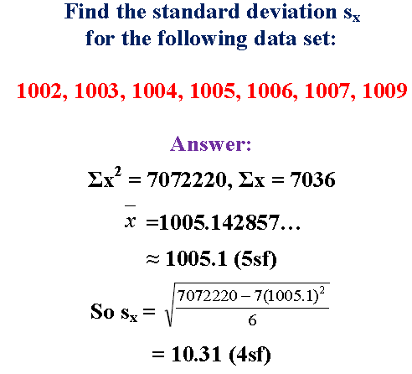
Identify the measures of dispersion
Calculate different measures of dispersion
Evaluate the strengths and weaknesses of each measure
Key words:
Central tendency
Dispersion
Spot the mistake!!

Slide 167
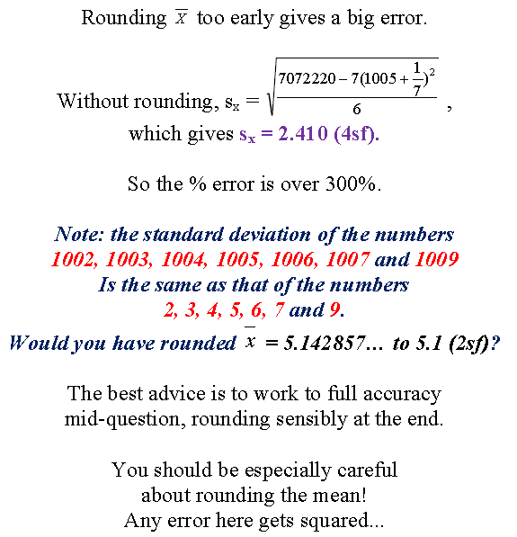
Identify the measures of dispersion
Calculate different measures of dispersion
Evaluate the strengths and weaknesses of each measure
Key words:
Central tendency
Dispersion
Spot the mistake!!

Slide 168
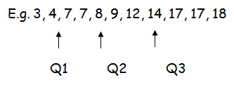
Identify the measures of dispersion
Calculate different measures of dispersion
Evaluate the strengths and weaknesses of each measure
Key words:
Central tendency
Dispersion
Q1 Q2 Q3
17-7 = 10 (Q3 – Q1 = Interquartile range)
Semi-interquartile range = 10
Interquartile range!
When data is put in order, find the first quartile (Q1) and the third quartile (Q3), simply subtract Q1 from Q3. Notice that the second quartile is the median
17-7 = 10 (Q3 – Q1 = Interquartile range)
Semi-interquartile range = 10

Slide 169
Identify the measures of dispersion
Calculate different measures of dispersion
Evaluate the strengths and weaknesses of each measure
Key words:
Central tendency
Dispersion
Q1 Q2 Q3
17-7 = 10 (Q3 – Q1 = Interquartile range)
Semi-interquartile range = 10
Interquartile range!
The advantage of the interquartile range over the range is that it is less affected by outliers (anomalous scores).

Slide 170
Identify the measures of dispersion
Calculate different measures of dispersion
Evaluate the strengths and weaknesses of each measure
Key words:
Central tendency
Dispersion
Q1 Q2 Q3
17-7 = 10 (Q3 – Q1 = Interquartile range)
Semi-interquartile range = 10
Remember!
If you use the mode as a measure of central tendency, the range is the appropriate measure of dispersion, the mean, standard deviation and the median is paired with the interquartile range.
Mode = Range
Mean = SD
Median = IQR

Slide 171
Identify the measures of dispersion
Calculate different measures of dispersion
Evaluate the strengths and weaknesses of each measure
Key words:
Central tendency
Dispersion
Q1 Q2 Q3
17-7 = 10 (Q3 – Q1 = Interquartile range)
Semi-interquartile range = 10
Graphs
Graphs are pictorial presentations of data. They should be chosen to enable the data to be displayed in the most effective and clear way possible. All diagrams must be fully labelled, care must be taken to select an appropriate scale so the data is not in any way capable of misrepresentation. All graphs should be accompanied by a sentence or two of explanation.

Slide 172
Identify the measures of dispersion
Calculate different measures of dispersion
Evaluate the strengths and weaknesses of each measure
Key words:
Central tendency
Dispersion
Q1 Q2 Q3
17-7 = 10 (Q3 – Q1 = Interquartile range)
Semi-interquartile range = 10
Bar Graphs
A bar chart is a diagram consisting of columns (bars), the heights of which indicate frequencies, so data on the x axis is discrete. A histogram is similar to a bar chart, but without gaps between columns, so the data is continuous on the x axis.

Slide 173
Identify the measures of dispersion
Calculate different measures of dispersion
Evaluate the strengths and weaknesses of each measure
Key words:
Central tendency
Dispersion
Q1 Q2 Q3
17-7 = 10 (Q3 – Q1 = Interquartile range)
Semi-interquartile range = 10
Bar Graphs
The x axis should be the IV
The y axis should be the results

Slide 174
Identify the measures of dispersion
Calculate different measures of dispersion
Evaluate the strengths and weaknesses of each measure
Key words:
Central tendency
Dispersion
Q1 Q2 Q3
17-7 = 10 (Q3 – Q1 = Interquartile range)
Semi-interquartile range = 10
Bar Graphs
Draw a bar chart for the following -
Children In Family | Frequency
Zero | 8
One | 11
Two | 17
Three | 8
Four | 5
Five | 1

Slide 175
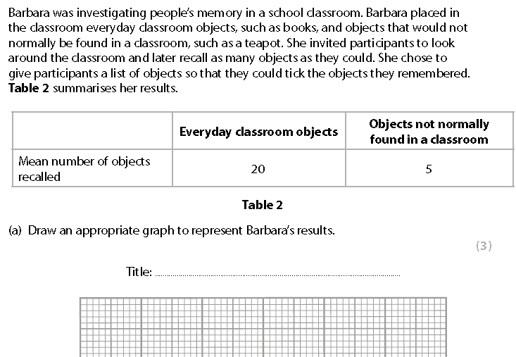
Identify the measures of dispersion
Calculate different measures of dispersion
Evaluate the strengths and weaknesses of each measure
Key words:
Central tendency
Dispersion
Q1 Q2 Q3
17-7 = 10 (Q3 – Q1 = Interquartile range)
Semi-interquartile range = 10
Exam question

Slide 176
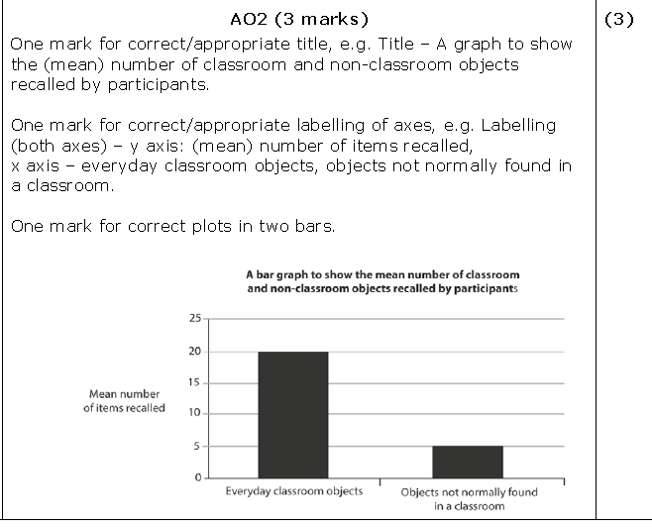
Identify the measures of dispersion
Calculate different measures of dispersion
Evaluate the strengths and weaknesses of each measure
Key words:
Central tendency
Dispersion
Q1 Q2 Q3
17-7 = 10 (Q3 – Q1 = Interquartile range)
Semi-interquartile range = 10
Exam question

Slide 177


Recommended texts
Simple Statistics by Francis Clegg
ISBN-13: 978-0521288026
Research Methods & Statistics in Psychology by Hugh Coolican
ISBN-13: 978-1444170115

