Slide 1
Notes:
Write on board:
Look at marked work handed back.
Get out 8 mark evaluation of reconstructive theory of memory (h/w).
Do the starter sheet.
I need to take the register & hand out scrap paper for later in the lesson.
Then need to go through homework (word document) – peer assess – switch work. Give them a strength & a target for improvement. Print & sign your name & include today’s date (which is 18th Nov).
Just want to highlight what we have already done – so they can see where we are with the course. Whilst students are giving final feedback – put this on the board & tick off what have already done.

Slide 2
Learning Objectives
To be able to describe Steyver & Hemmer’s (2012) contemporary key study.
To be able to evaluate Steyver & Hemmer’s (2012) contemporary key study.
To be able to answer exam questions about Steyver and Hemmer’s (2012) key study.

Slide 3
Starter: Episodic or semantic memory?
Your first day of school.
Putting your tooth under a pillow.
Washington DC is the capital of the USA.
Blue and yellow paint mixed together makes green paint.
Getting your GCSE results.
Your last family holiday.
Photosynthesis leads to the production of glucose & O₂.
The first time you went into town on your own.
A flock of crows is known as a murder.
Can you think of episodic and semantic memories from your psychology lessons?!

Slide 4
Starter (Cont):
What is a schema?
Think of a possible schema for an office (including fixed & variable items).
Office
Notes:
Cover fixed features first, then variable features second. (could just put a V/F afterwards – they can colour code – too much hassle for me to do that).

Slide 5
So... You think you have a good memory?! Let’s find out!!!
Background for the key study

Slide 6
Look, listen & remember these words...
Sour
Candy
Sugar
Bitter
Good
Taste
Tooth
Nice
Honey
Soda
Chocolate
Heart
Cake
Tart
Pie
Notes:
I will read through the words, then they will have a minute to recall them (order doesn’t matter for the purpose of this experiment).

Slide 7
Now...
On your ‘scrap’ paper, write as many of those words as you can.

Slide 8
Answers
Sour
Candy
Sugar
Bitter
Good
Taste
Tooth
Nice
Honey
Soda
Chocolate
Heart
Cake
Tart
Pie
How many of you remembered the word ‘sweet’????
Notes:
This is to show that your memory for items is not necessarily accurate – it is not a faithful record of what happened. Rather, it is a reconstruction of what you think happened (schema theory – activated your schema for sweet things).

Slide 9
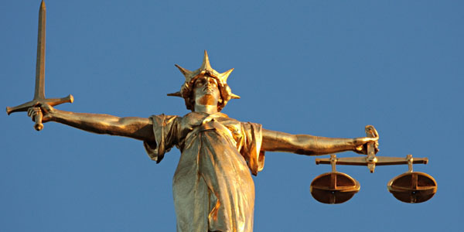
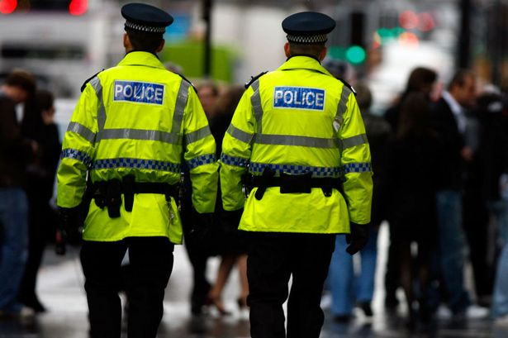
Who might be interested in knowing whether people have an accurate or inaccurate memory?
Notes:
Justice scales – Old Bailey – London (Highest court)
Police
Judges
want accurate testimonies from eyewitnesses (people who have seen crimes) in order to bring about justice – real criminal gets convicted and a genuinely innocent person doesn’t get punished.
From our previous little experiment – it seems that our memory isn’t very good. But that was memory for words – eyewitnesses don’t often see words, they see scenes (T/F our little experiment lacks mundane realism). So… I’m going to show you a picture of a scene on the next slide for 35 seconds, and I am going to ask you questions about it afterwards.

Slide 11
But…
Why might our little (sweet) experiment been unrepresentative of what real eyewitnesses have to do?
Notes:
They don’t normally look and remember lists of words – so it lacks mundane realism.

Slide 12
So…
I’m going to show you a picture of a scene on the next slide for 35 seconds; you need to remember this scene.
Pay attention!
Notes:
Will you make a good eyewitness???

Slide 13
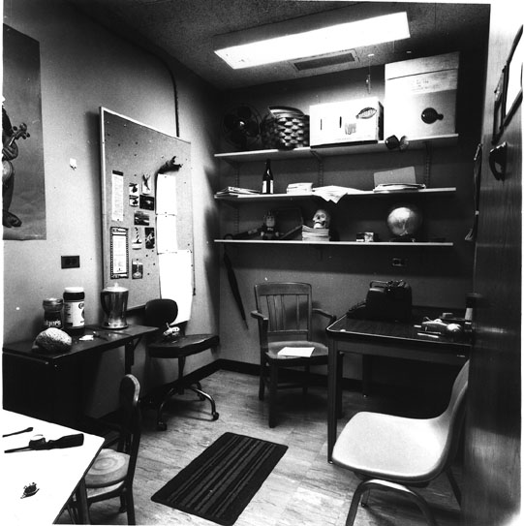
Notes:
Look at this graduate student’s office.
(Includes some unexpected items – e.g. Skull & misses other expected items – e.g. Books)
Look at this image for 35 seconds.

Slide 14
Now...
On your scrap piece of paper, write down as many items from the room as you can.

Slide 15
Answers
A total list of the objects in the room can be found on Moodle, in the Brewer & Treyens (1981) article.
Did you see the skull? There was one!
Did you recall having seen books? Filing cabinets? Coffee cup? Pens? Window? Curtains? Ball? Lamp? Pencils? Telephone? There weren’t any!
Notes:
This is a replication of the Brewer & Treyens (1981) study. I’ve signposted you to that list because there are soooo many different items. I’m not interested in how many you got. I’m interested in whether you spotted/missed some items.
They tend to miss out unusual items that are present – if missed it – this would fit what Brewer & Treyens found.
They tend to include usual items which are not present – if included it – this is an error – they weren’t there. If did include them – this would fit what Brewer & Treyens found.
So – this study tells us that memory is not good. But… why was this study not a good study? Because it lacks ecological validity.

Slide 16
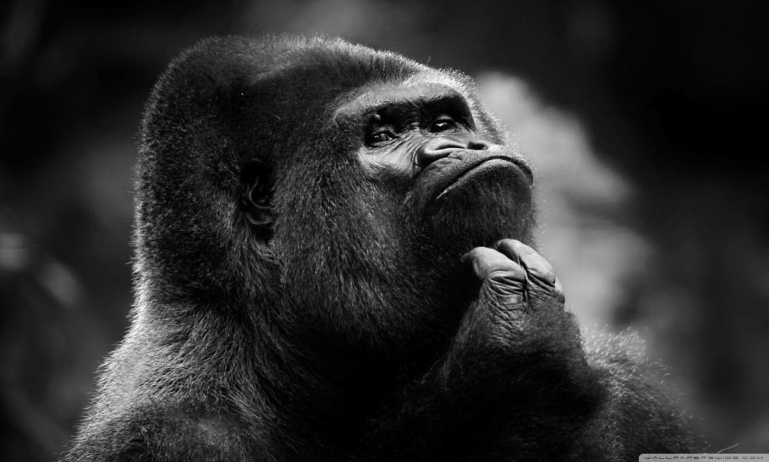
But…
Why might Brewer & Treyens’ (1981) experiment not be representative of how our memory really works in everyday life?
Notes:
In real life, there is not necessarily going to be unusual items present and there may be usual items present.
T/F it lacks ecological validity.

Slide 17
So…
Steyvens & Hemmer (2012) decided to do a study with higher ecological validity (higher mundane realism) so see whether our memory for real scenes is any good (or not!).

Slide 18
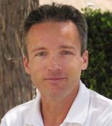
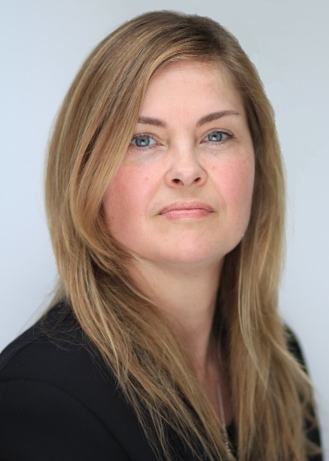
Key Contemporary Study: Steyvers & Hemmer (2012)
Notes:
Again – won’t tell them the title of the study (reconstruction from memory in a naturalistic environment) because I want to replicate some/all of it – and that would bias the results etc.
This study we have chosen to do. Cannot be asked ‘what was the aim of Steyvers & Hemmer (2012)’. Asked something along the lines of... You have studied one contemporary study in Cognitive Psychology. Outline the aim of this study; making clear which study it is in your answer.
Mark Stemmer
Pernille Hemmer

Slide 19
Instructions
I am going to show you a series of images.
After I have shown each image you will have time to write down the items you saw in each image.
Please put your pen down when you have finished writing.
I will move on once the last person has put their pen down.
Ready?!
Notes:
Intentionally not saying any more, because I don’t want any more demand characteristics than is absolutely necessary!!!!

Slide 20
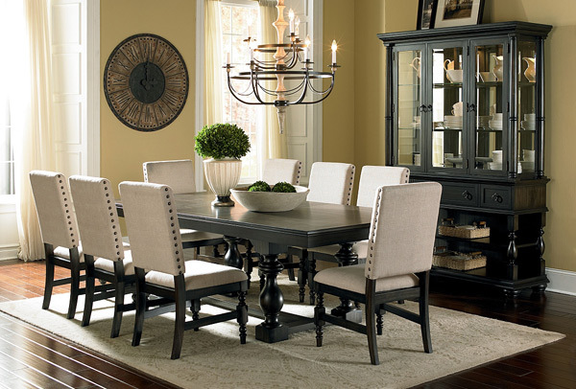
1.
Notes:
Show image for 10 seconds

Slide 21
1. Now...
Write down every item that you remember from that scene.
Put your pen down when you have finished, so that I know I can move on.
Notes:
As soon as the last person puts their pen down – I can move on (free recall – like in the original study)
Put a number 2 on sheet – ready for the next scene.

Slide 22
2.
Notes:
Show image for 10 seconds

Slide 23
2. Now...
Write down every item that you remember from that scene.
Put your pen down when you have finished, so that I know I can move on.
Notes:
As soon as the last person puts their pen down – I can move on (free recall – like in the original study)

Slide 24
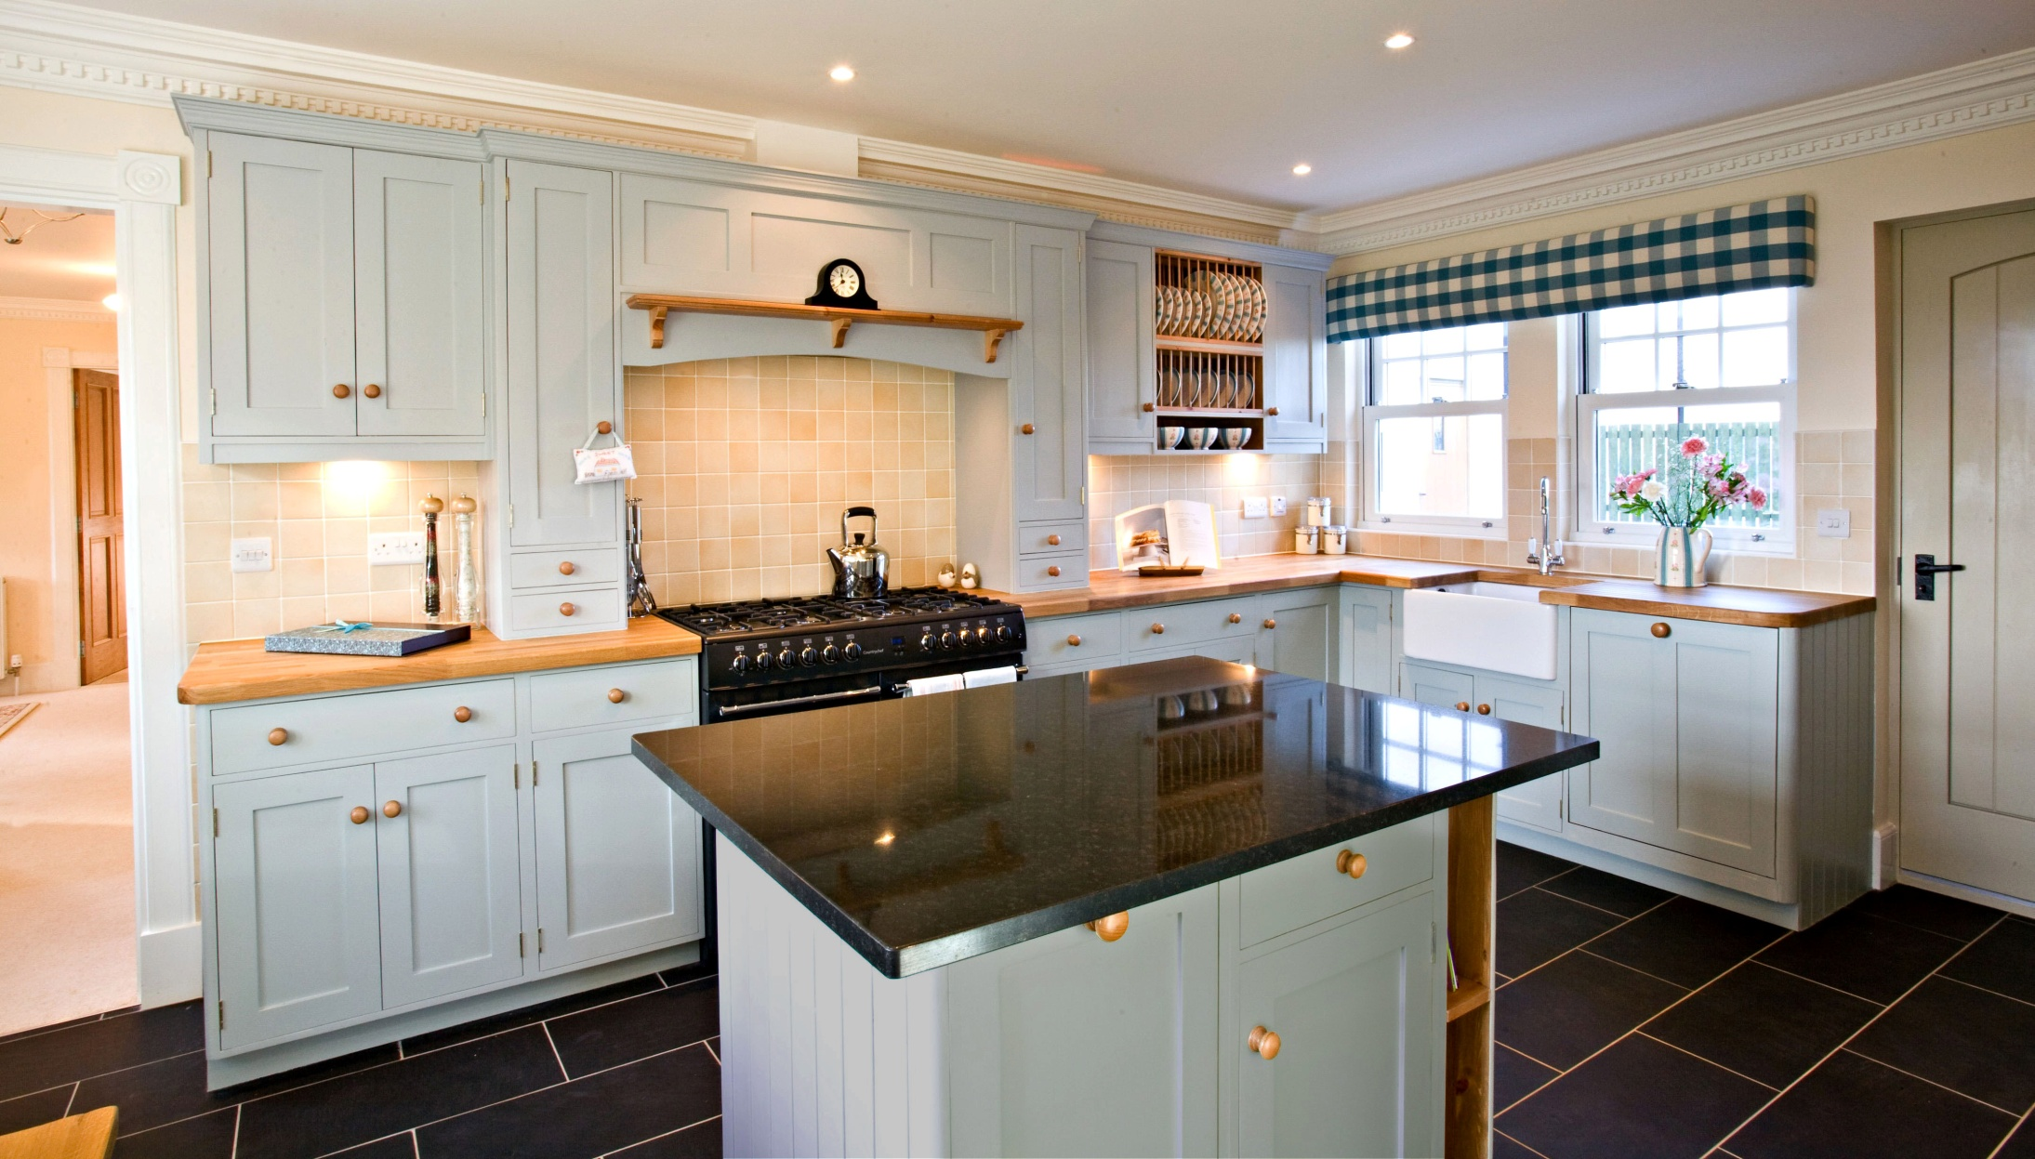
3.
Notes:
Show image for 10 seconds

Slide 25
3. Now...
Write down every item that you remember from that scene.
Put your pen down when you have finished, so that I know I can move on.
Notes:
As soon as the last person puts their pen down – I can move on (free recall – like in the original study)

Slide 26
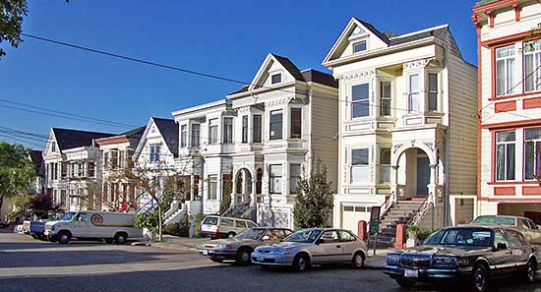
4.
Notes:
Show image for 2 seconds

Slide 27
4. Now...
Write down every item that you remember from that scene.
Put your pen down when you have finished, so that I know I can move on.
Notes:
As soon as the last person puts their pen down – I can move on (free recall – like in the original study)

Slide 28
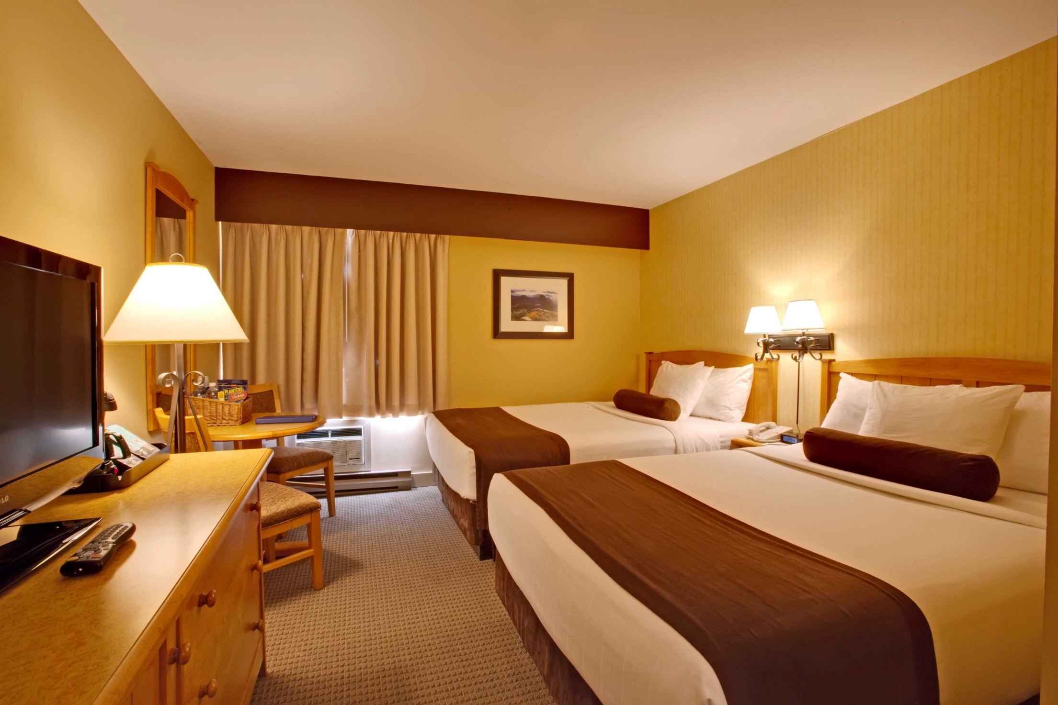
5.
Notes:
Show image for 2 seconds

Slide 29
5. Now...
Write down every item that you remember from that scene.
Put your pen down when you have finished, so that I know I can move on.
Notes:
As soon as the last person puts their pen down – I can move on (free recall – like in the original study)

Slide 30
Lets Mark!
Switch answers with somebody else.
You will be shown each of the scenes again.
Give a tick for each correct response.
Put a cross next to each incorrect response (i.e. Error).
Count up the total number of ticks per scene.
Count up the total number of errors per scene.
Ask if you have any questions.

Slide 31
1. Dining Room Scene
Notes:
Do together – of not sure about an item – ask – because somebody else may be thinking the same thing.

Slide 32
2. Office Scene

Slide 33
3. Kitchen Scene

Slide 34
4. Urban Scene

Slide 35
5. Hotel Scene

Slide 36
Questions to Consider
What was the DV in this study?
What do you think the IV was in this study?
What type of experimental design was used in this study?
What do you think the aim of the experiment was?
Check against the notes (page 30). How did your results compare with those obtained by Steyvens & Hemmer (2012)?
Notes:
Number of correct items recalled.
Length of time exposed to the image for (short – 2 seconds – believed to be reliant on semantic memory, because didn’t have the time to create an episodic memory; long – 10 seconds – believed to be reliant on episodic memory, because had the time to create this). So the first 3 scenes (dining, office & kitchen) were ‘long’ and the last 2 scenes (urban & hotel) were ‘short’.
Repeated measures – did both conditions (short/semantic vs long/episodic)
When check against the notes –
When get to the results bit – did they get around 7-8 items in the short (semantic) conditions (last 2)? Did they get around 10 items in the long (episodic) conditions (first 3)? Hands up. Did you get more items in the long (episodic) condition than the short (semantic) condition?
When get to the errors, was it less than 20%? You got at least 4 answers right for every incorrect answer?
when get to this bit about effect of prior knowledge – get them to look at what they said in the starter in comparison to their answer for the office (2) – did they also identify more items in the ‘experiment’ than they did in the starter? Did their episodic memory enhance their semantic memory? If not – why might this have been the case?

Slide 37
Evaluate Steyvers & Hemmer (2012)
State
How
Why
Notes:
They will have done a few of these – so have left most of it blank for them to do.
When evaluating – only include standardised procedure in the reliability section.
The notes make reference to ecological validity – remember that means mundane realism because generalisability has already been extracted.
Will also need to extract internal validity.
High internal validity
There was a clear IV (length of time that Ps saw each scene for) & DV (how many correct answers they got). In addition there was an attempt to control potential extraneous variables (e.g. In order to prevent interference participants only viewed one image from each of the 5 scenes rather than multiple images from the same scene; in order to control for potential practise and order effects, participants were randomly allocated to one of the time ordering sequences and there was counterbalancing of the IV manipulations).

Slide 38
Possible exam questions about this contemporary study
During your course you will have studied one contemporary study in cognitive psychology...
What was the aim of this study?
What was the procedure of this study? What did participants have to do?
What were the findings of this study?
What were the conclusions of this study?
Describe this study.
What was one strength of this study?
What was one weakness of this study?
Evaluate this study (8).
Notes:
What do you notice?? We CHOSE this study T/F it can’t be named specifically ☺

Slide 39
Exam Questions to Practise
Choose one of the following to practise now in exam conditions: During your course you will have studied one contemporary study in cognitive psychology...
Describe the aim and conclusions for this study. (4)
Describe the procedure for this study. (4)
Describe the findings for this study. (4)
Outline one strength and one weakness of this study. (4)
Make sure you identify your chosen study in your answer.
[4 marks = 6 minutes]
Notes:
Give the students 6 minutes to do this.

Slide 40
Peer Marking
4 = accurate and thorough
3 = accurate (but not thorough)
2 = some inaccuracies
1 = lots of inaccuracies and omissions
Feedback:
* (something that went well)
T (something that could be improved next time).

Slide 41
Homework – Friday 20th Nov
Notes:
Complete this A3 page about yourself ready for Friday’s lesson (when we look at individual differences).

Slide 42
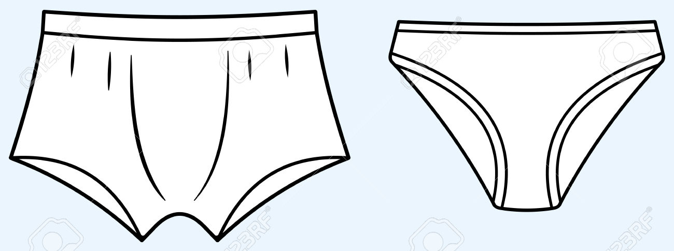
Homework – Monday 23rd Nov
You have 212 (like what I did there: Steyvers & Hemmer, 2012!!!!) words MAX to create a BRIEF summary of this key study.
Use as many pictures, diagrams, abbreviations, numbers etc as you wish.
Make it a thing of beauty!
Notes:
Got your Baddeley briefs.
Now I want Steyvers & Hemmer briefs.
Last time – you tended to copy out your notes & then stop when you got to your word count... Only include important points. Process it at a deeper, semantic level & it will stay in LTM ☺

Slide 43
Homework – Tuesday 24th
Write an 8 mark evaluation of the Steyvers & Hemmer (2012) study. Remember:
A01
State
How
Why
For each evaluation point!
You want 4 evaluation points )2 strengths & 2 weaknesses).

Slide 44
Learning Objectives Revisited
Can you now:
Describe Steyver & Hemmer’s (2012) contemporary key study?
Evaluate Steyver & Hemmer’s (2012) contemporary key study?
Answer exam questions about Steyver and Hemmer’s (2012) key study?

